Slide 1
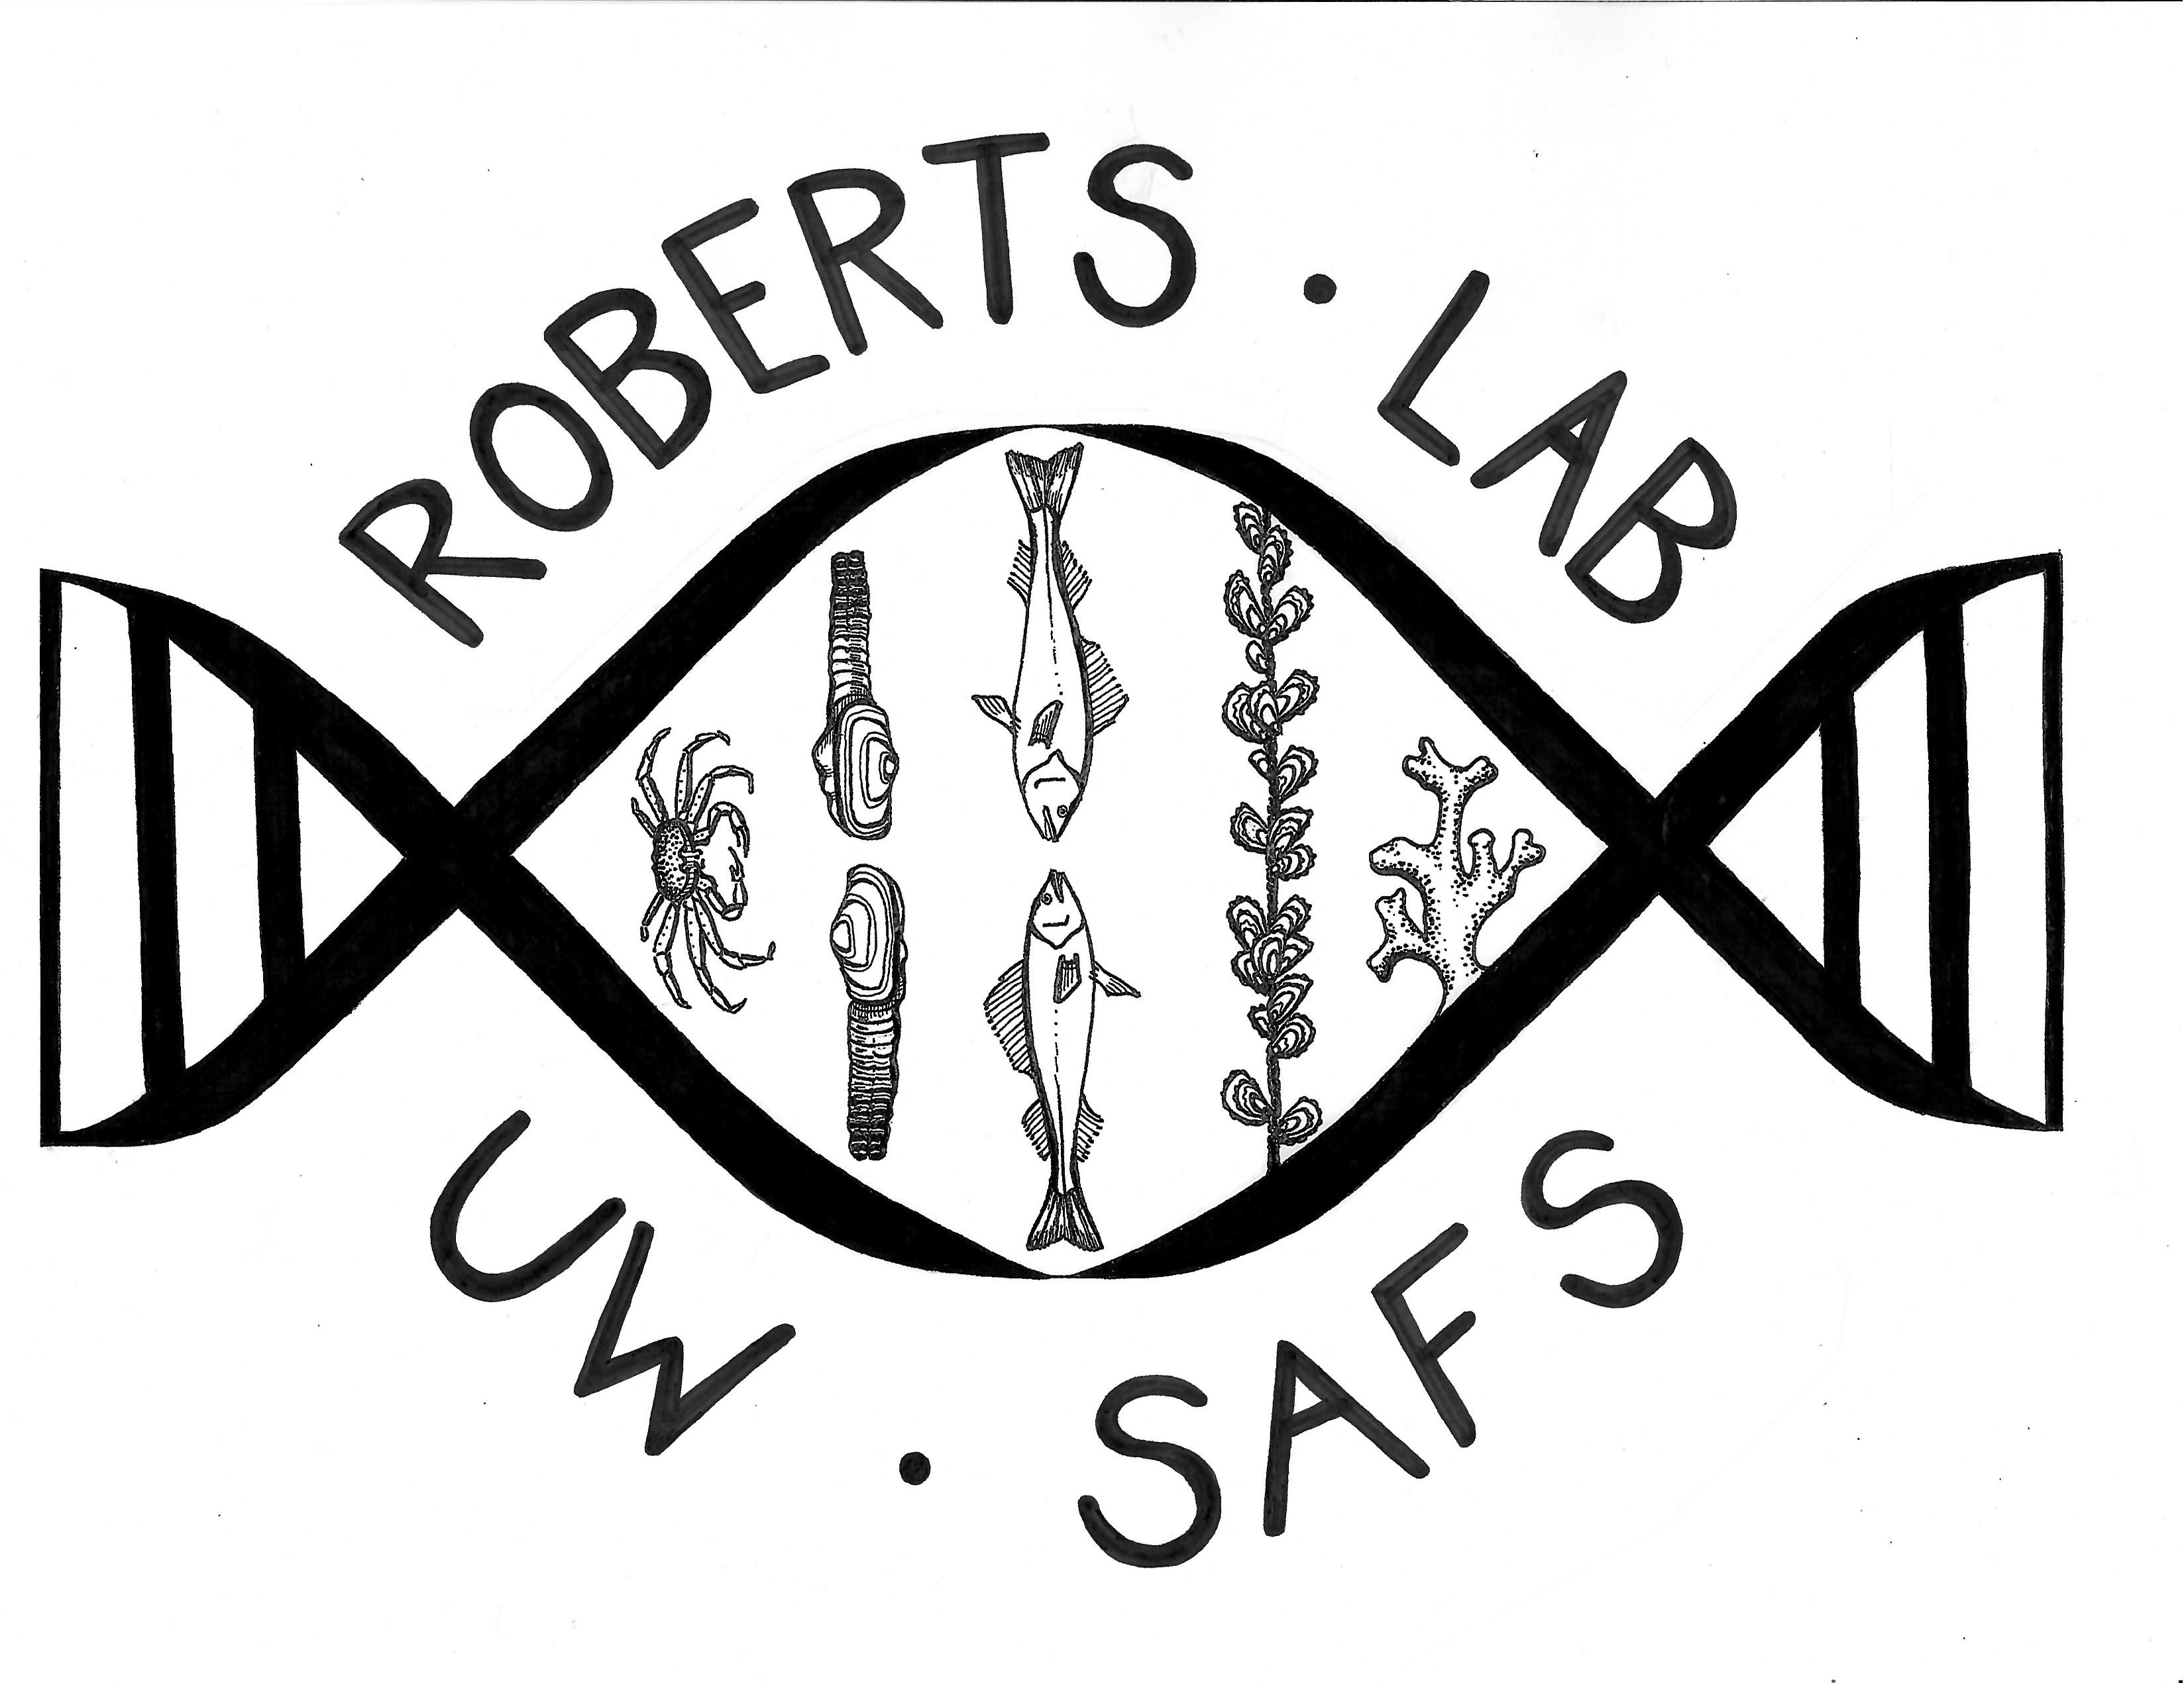






Diversity in animal response to environmental change
Shelly A. Trigg
shelly.trigg@gmgi.org
shellytrigg.github.io
Research Scientist
Gloucester Marine Genomics Institute, Gloucester, MA
Notes:
Hi My name is Shelly Trigg and I am a research scientist at the Gloucester Marine Genomics Institute in Gloucester, MA which is home of the oldest commercial fishing port in the country. GMGI is a non-profit founded in 2013 and is focused on addressing ocean, human health, and environment challenges through research and education.
I am a former UW Data science postdoc and worked with Steven Roberts in the School of Aquatic and Fishery Sciences at the University of Washington. Today I’m going to be sharing a culmination of a series of laboratory experiments including some of my graduate work done at the NOAA Northwest Fishery Science Center looking at how the environment influences different animals at the molecular level.
I'd first like to thank the organizers, the data science alliance, and sarah stone at UW eScience Institute for putting this series together
I want to acknowledge the funding for these experiments including the NSF GRFP, NOAA OAP, WA SeaGrant, and USDA

Slide 2
Outline
Background on environmental change and omics
Exposure experiments and omics analyses in different marine animals
Summary of the diversity in animal responses
Future directions
Notes:
First I’m going to provide some background on environmental change and genomics technologies. I’m then going to walk you through a number of different exposure experiments on

Slide 3
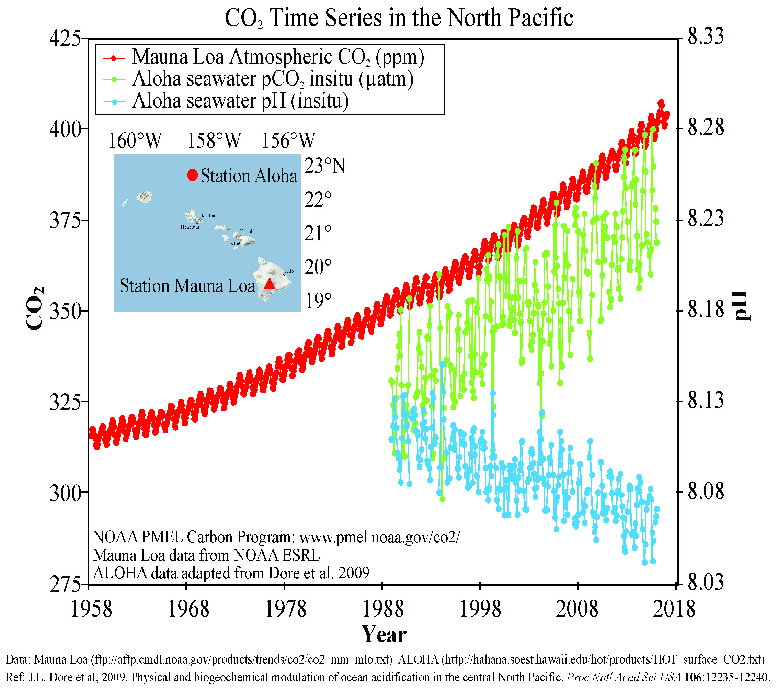
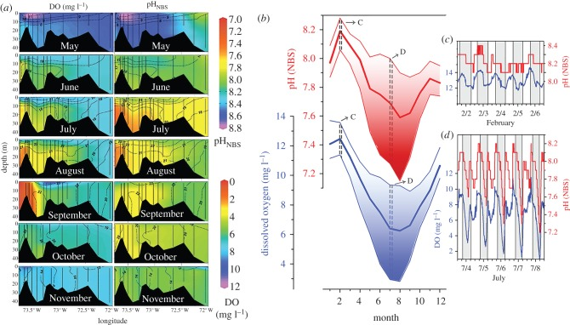
Global ocean change is happening
1958-2018 Carbon Emissions
Ocean Acidification
Since 1850s,
global average ocean surface water has:
– 0.11 in pH
+ 30% in H⁺ ions
Ocean deoxygenation:
pH and O₂ co-vary
Ocean warming:
Long Island Sound
atmospheric CO₂
25%
ANNUALLY
ocean CO₂
ocean pH
Ocean salinity variation
Gobler and Baumann (2016) Biology Letters
Notes:
I started becoming passionate about understanding climate change and global ocean change because there is a lot of confusion over climate and ocean change impact. I want everyone to see how atmospheric carbon dioxide has been increasing over time. This is from 1958-2018. Ocean carbon dioxide is also increasing overtime and this correlates with a decrease in ocean pH. This is ocean acidification. Since the start of the industrial revolution in the 1850’s, global average ocean surface waters have decreased by 0.11 pH which corresponds to a 30% increase in H+ ions. Each year 25% of human caused CO2 emissions are absorbed by the ocean, which causes an increase in carbonic acid formation and a decrease in ocean pH. Compound this problem, Oxygen levels co-vary with pH, and not as much oxygen can dissolved in water which has to do with ocean warming due to increase atmospheric Co2. There are many marine species that ecosystems and our economy rely on and there is concern on how these animals will deal with these changing waters.

Slide 4
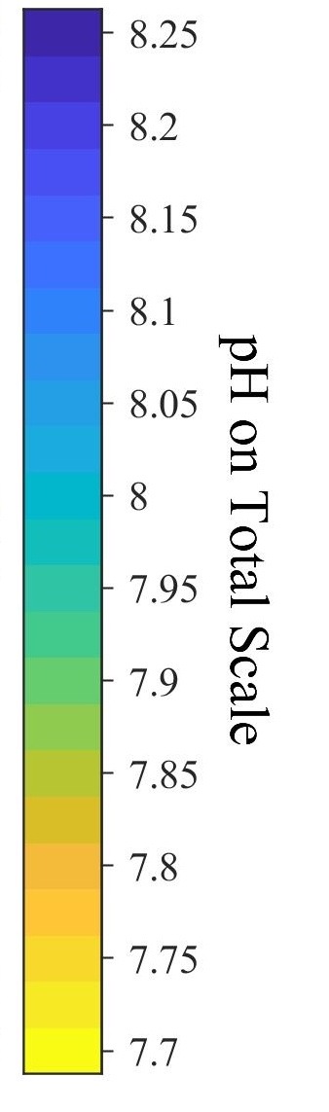
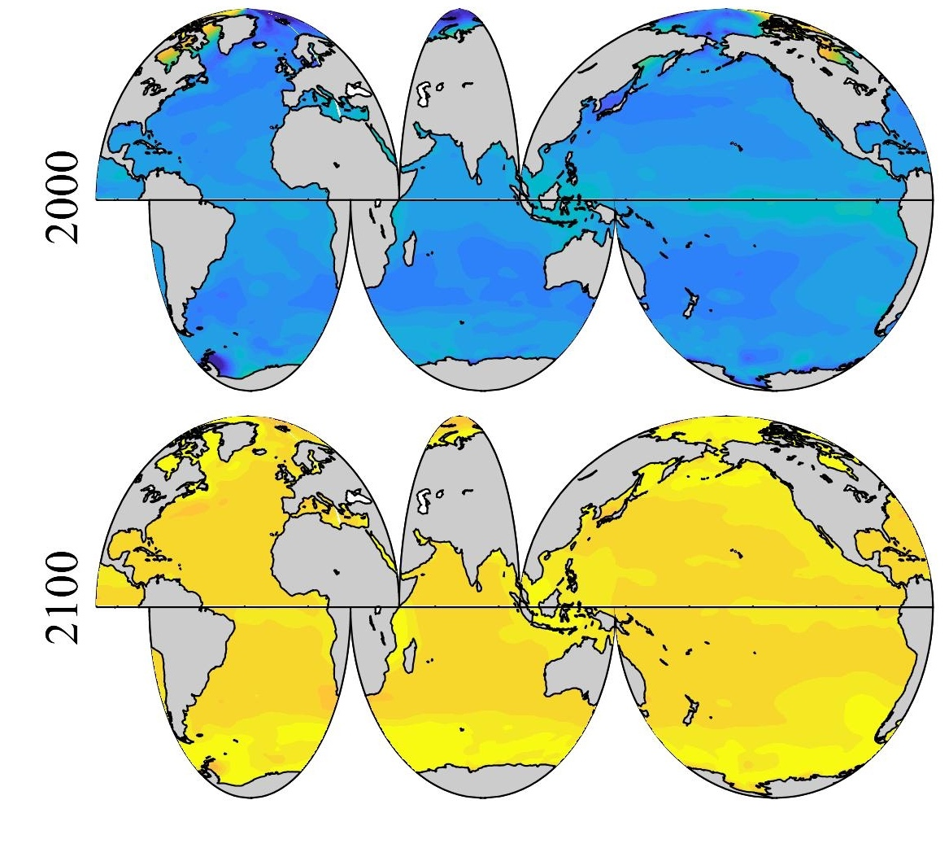
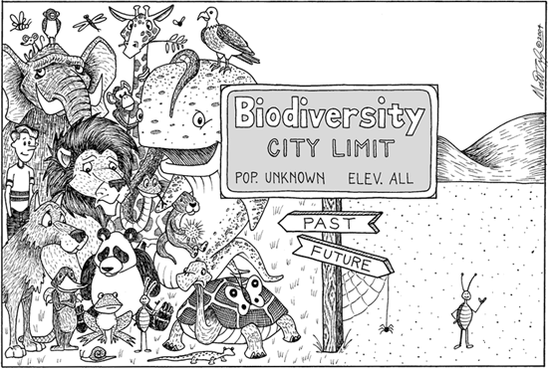
How will climate and ocean change affect different animals?
Surface Ocean pH
?
Surface Ocean temperature change
Notes:
Because animals are diverse they have diverse responses. So it would be hard to just pick one particular molecule or pathway to study across all organisms to use an indicator of performance.
Traditional approaches could take a long time, so how can we get a lot of information quickly to understand how different animals respond to environmental change?

Slide 5
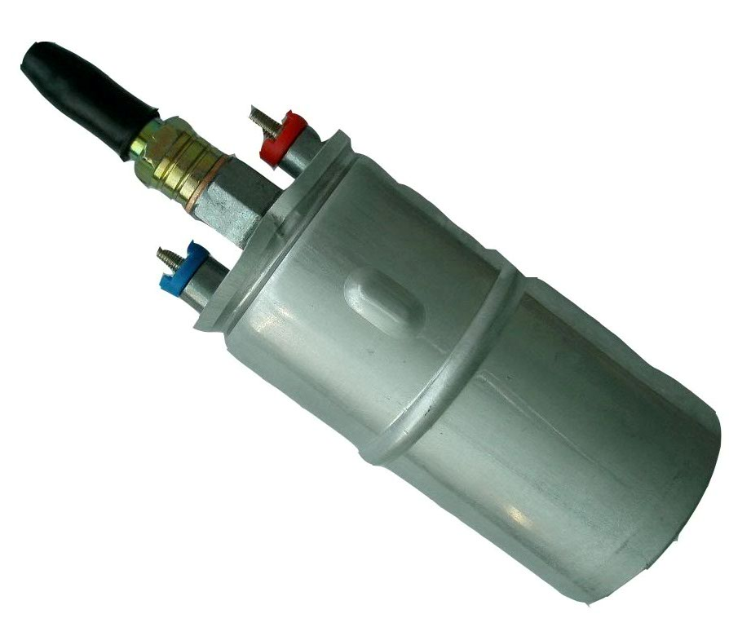
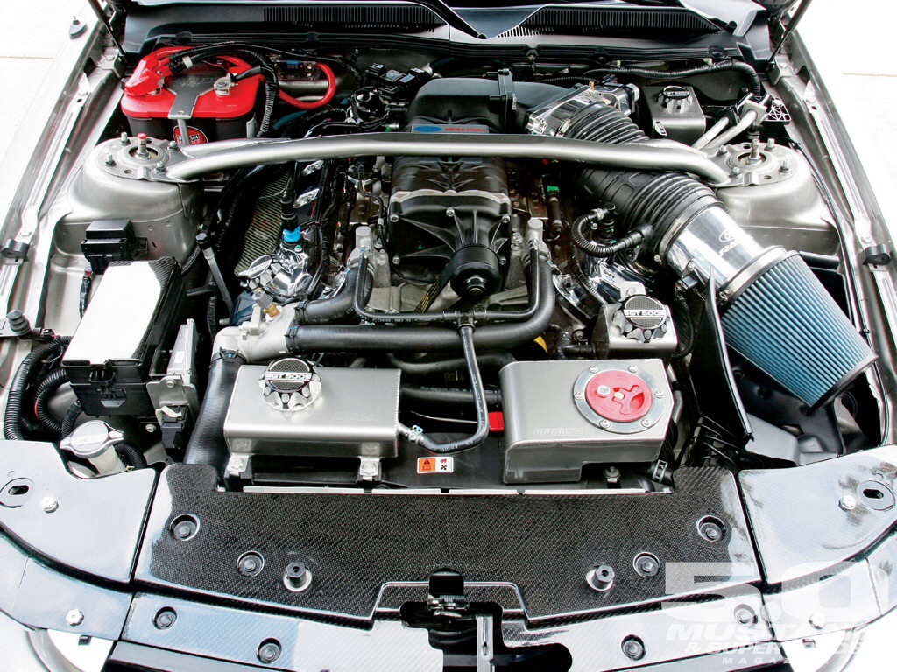

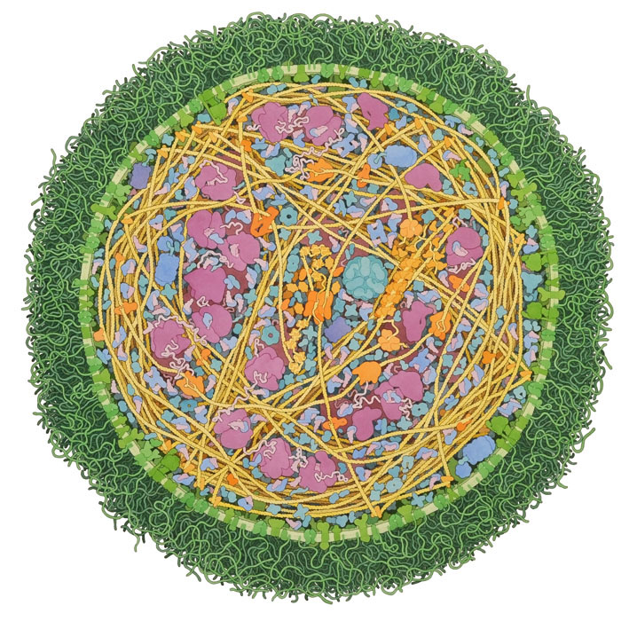



Systems Biology: A bird’s eye view
Individual parts view
System-wide view
air intake
fuel pump
Auto mechanics
starter
Mycoplasma cell
ribosome
receptor
Biology
chaparonin
Why it’s important
Complex systems = many interconnected parts
Compare across different animals
All animals have these basic parts
David Goodsell, TSRI
Notes:
Rather than studying one particular molecule, we can study molecular systems and look how collection of molecules work together to make biological processes happen. Similar to how different car parts work together to make a car run. Cells are like cars in that they are complex systems with many working parts. Some cars perform better than others in different environments and trying to understand why comes down to understanding how the different car parts work together. If we can understand the mechanics of cells from this system-wide perspective, we could compare across species and better understand which animals might do better in different environments.
So how can we get this birds eye view of networks in cells?

Slide 6
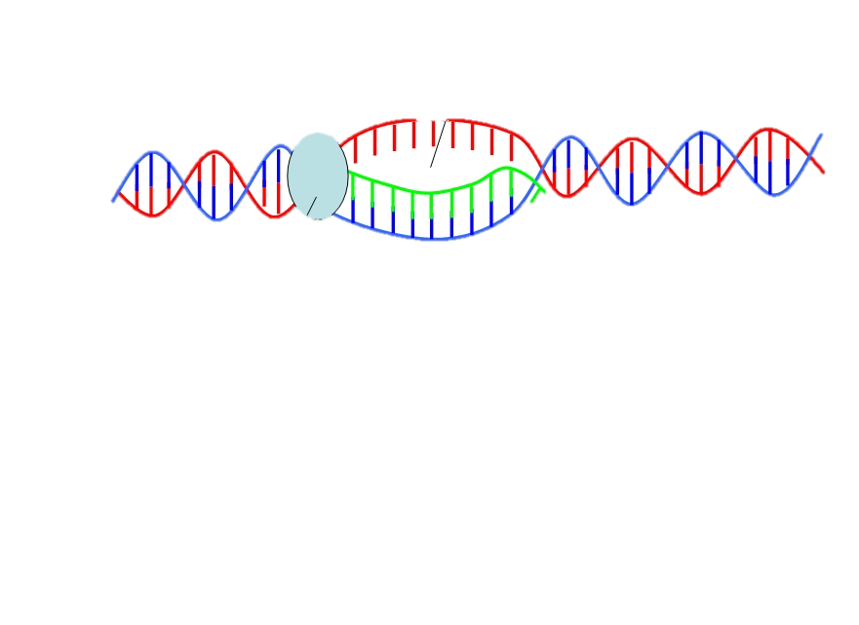
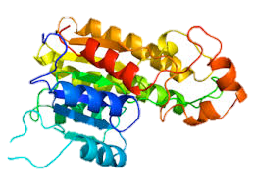
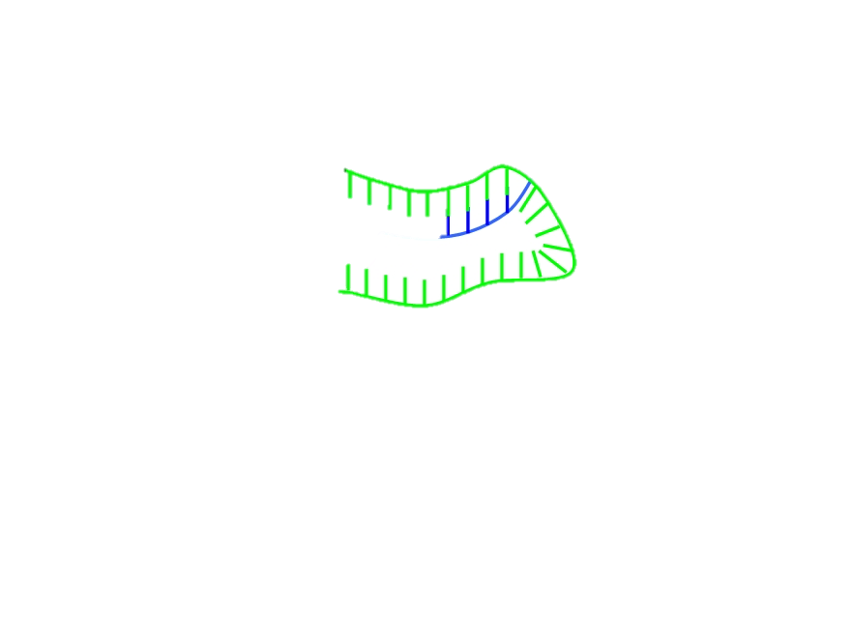
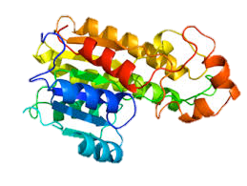
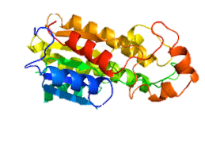
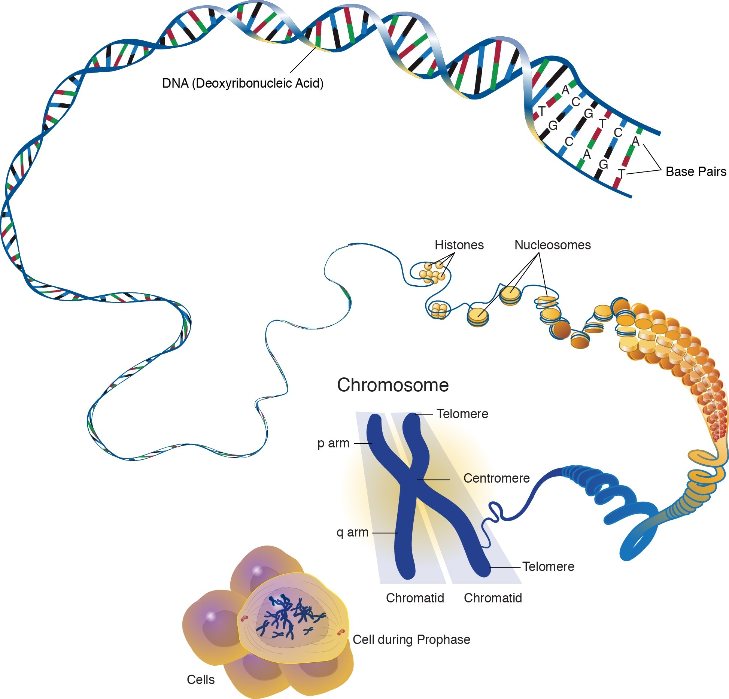
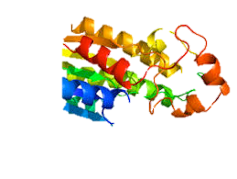
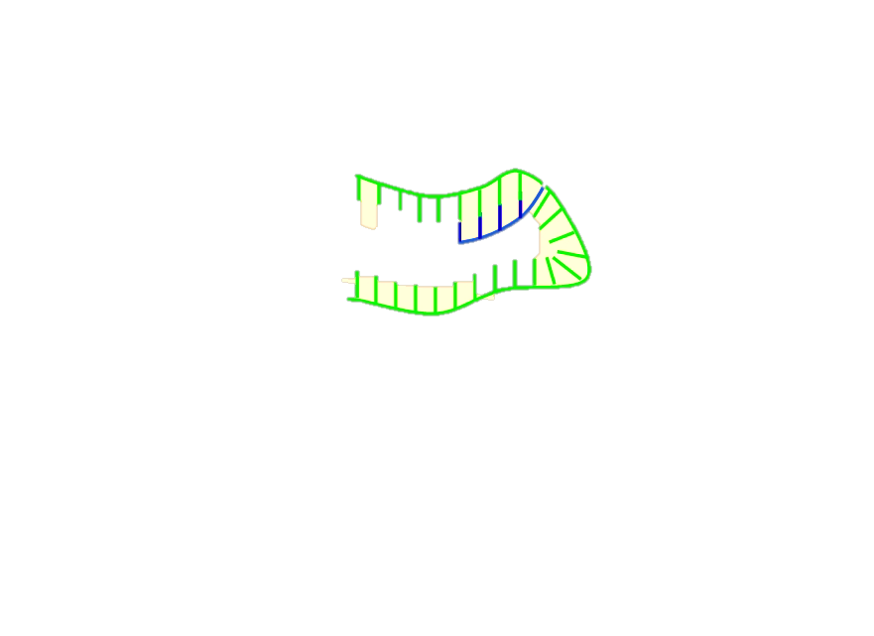

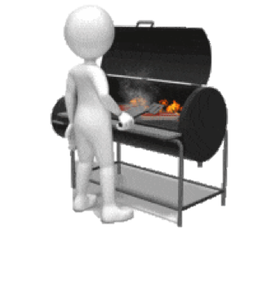








‘omics’ is the study of collections of biological components
DNA
RNA
DNA
RNA
DNA
RNA
DNA
RNA
DNA
RNA
Genome
all genes or genetic material
Transcriptome
all RNA strands transcribed from DNA
Proteome
all proteins
Interactome
all interactions between proteins
Metabolome
all small molecule byproducts of biochemical reactions (metabolites)
Meal prep analogy
Recipe
1.
2.
3.
4.
Notes:
We can use omics technologies. These allow us to see snap shots of collections of biological components, like how genomic sequencing allows us to see all the genetic material in cells. For reference, these different biological components we can look at with omics technologies can be likened to how a big meal is prepared. The genome is the big recipe for cell activity, the transcriptome is like all the orders that get shouted across the kitchen, and call for different sous chefs to come and cook. The sous chefs are like proteins, with each sous chef bringing their own unique skills, and the collection of sous chefs that are called are like the proteome. The sous chefs work together to grill steaks or make soup, just like how proteins with unique activity interact to drive different biological processes. In the end the sous chefs make a whole spread of food similar to the whole spread of metabolites (or metabolome) that get created from proteins working together.
Today I'm going to be focusing on interactomes and metabolomes, but I first want to show you a couple examples of how using omics to get a system-wide view can help us understand biology.

Slide 7
Outline
Background on environmental change and omics
Exposure experiments and omics analyses in different marine animals
Summary of the diversity in animal responses
Future directions

Slide 8
Metabolome response to ocean acidification
DNA
RNA
DNA
RNA
DNA
RNA
DNA
RNA
DNA
RNA
Genome
all genes or genetic material
Transcriptome
all RNA strands transcribed from DNA
Proteome
all proteins
Interactome
all interactions between proteins
Metabolome
all small molecule byproducts of biochemical reactions (metabolites)
Meal prep analogy
Recipe
1.
2.
3.
4.

Slide 9

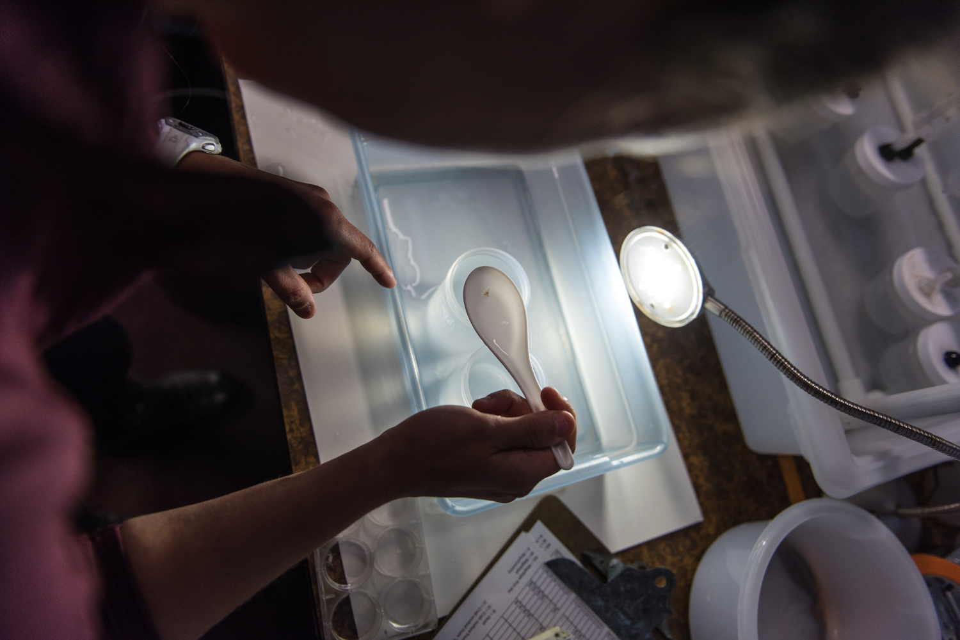
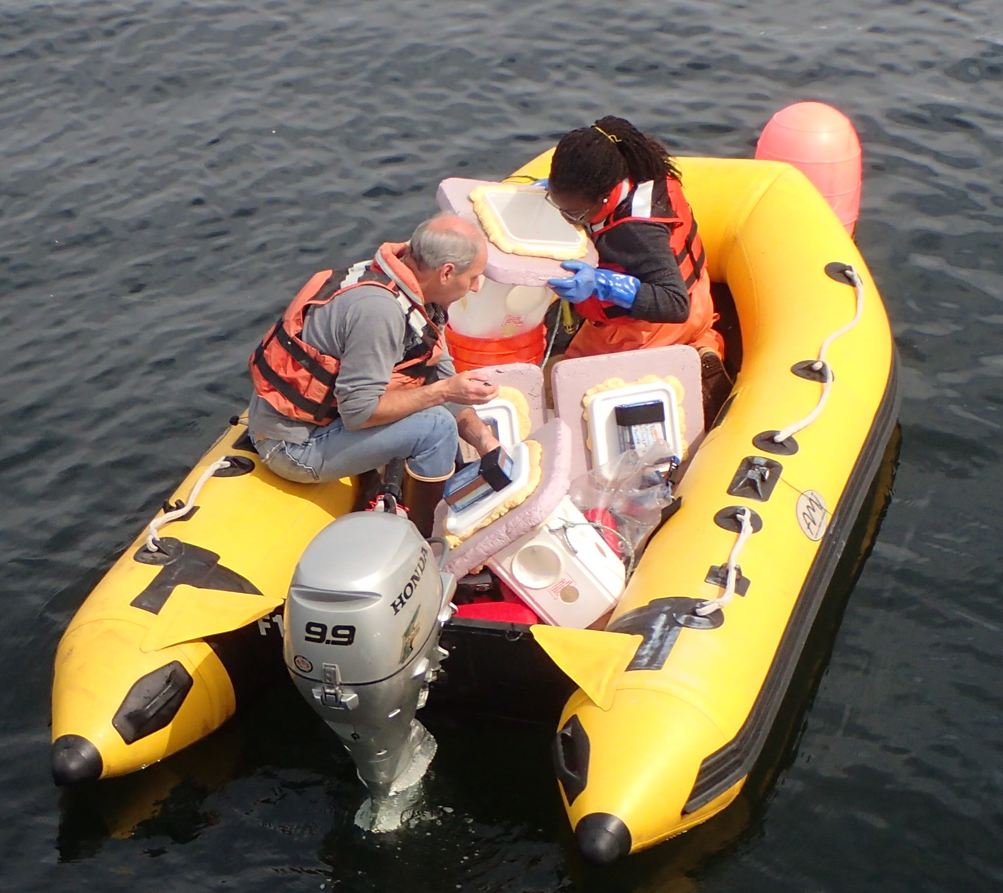
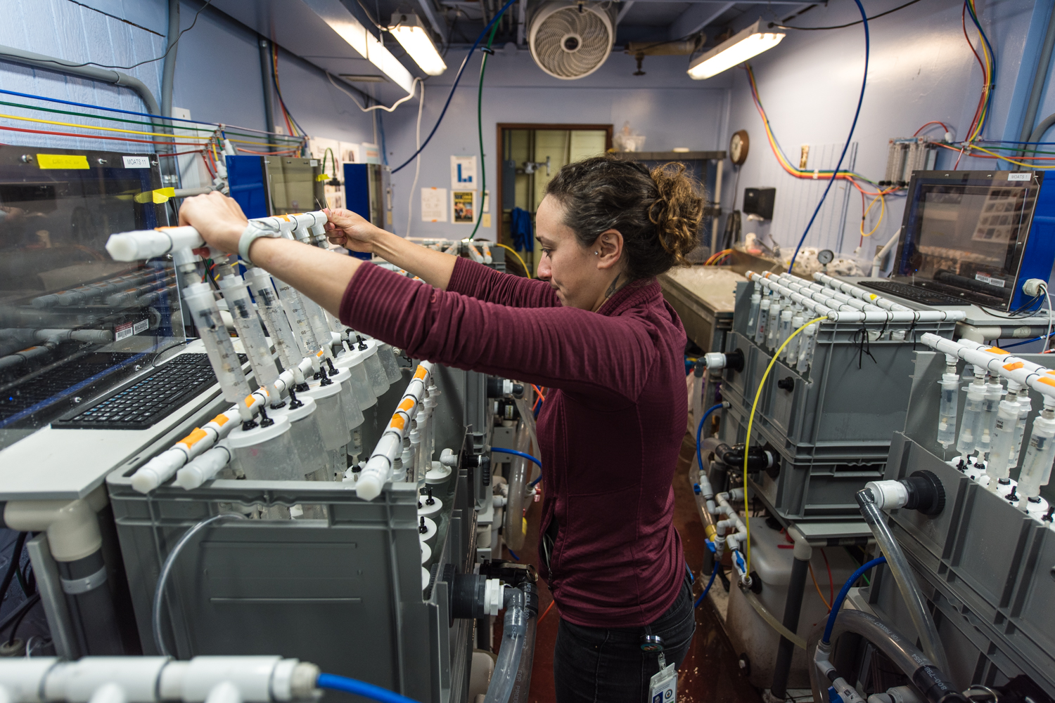
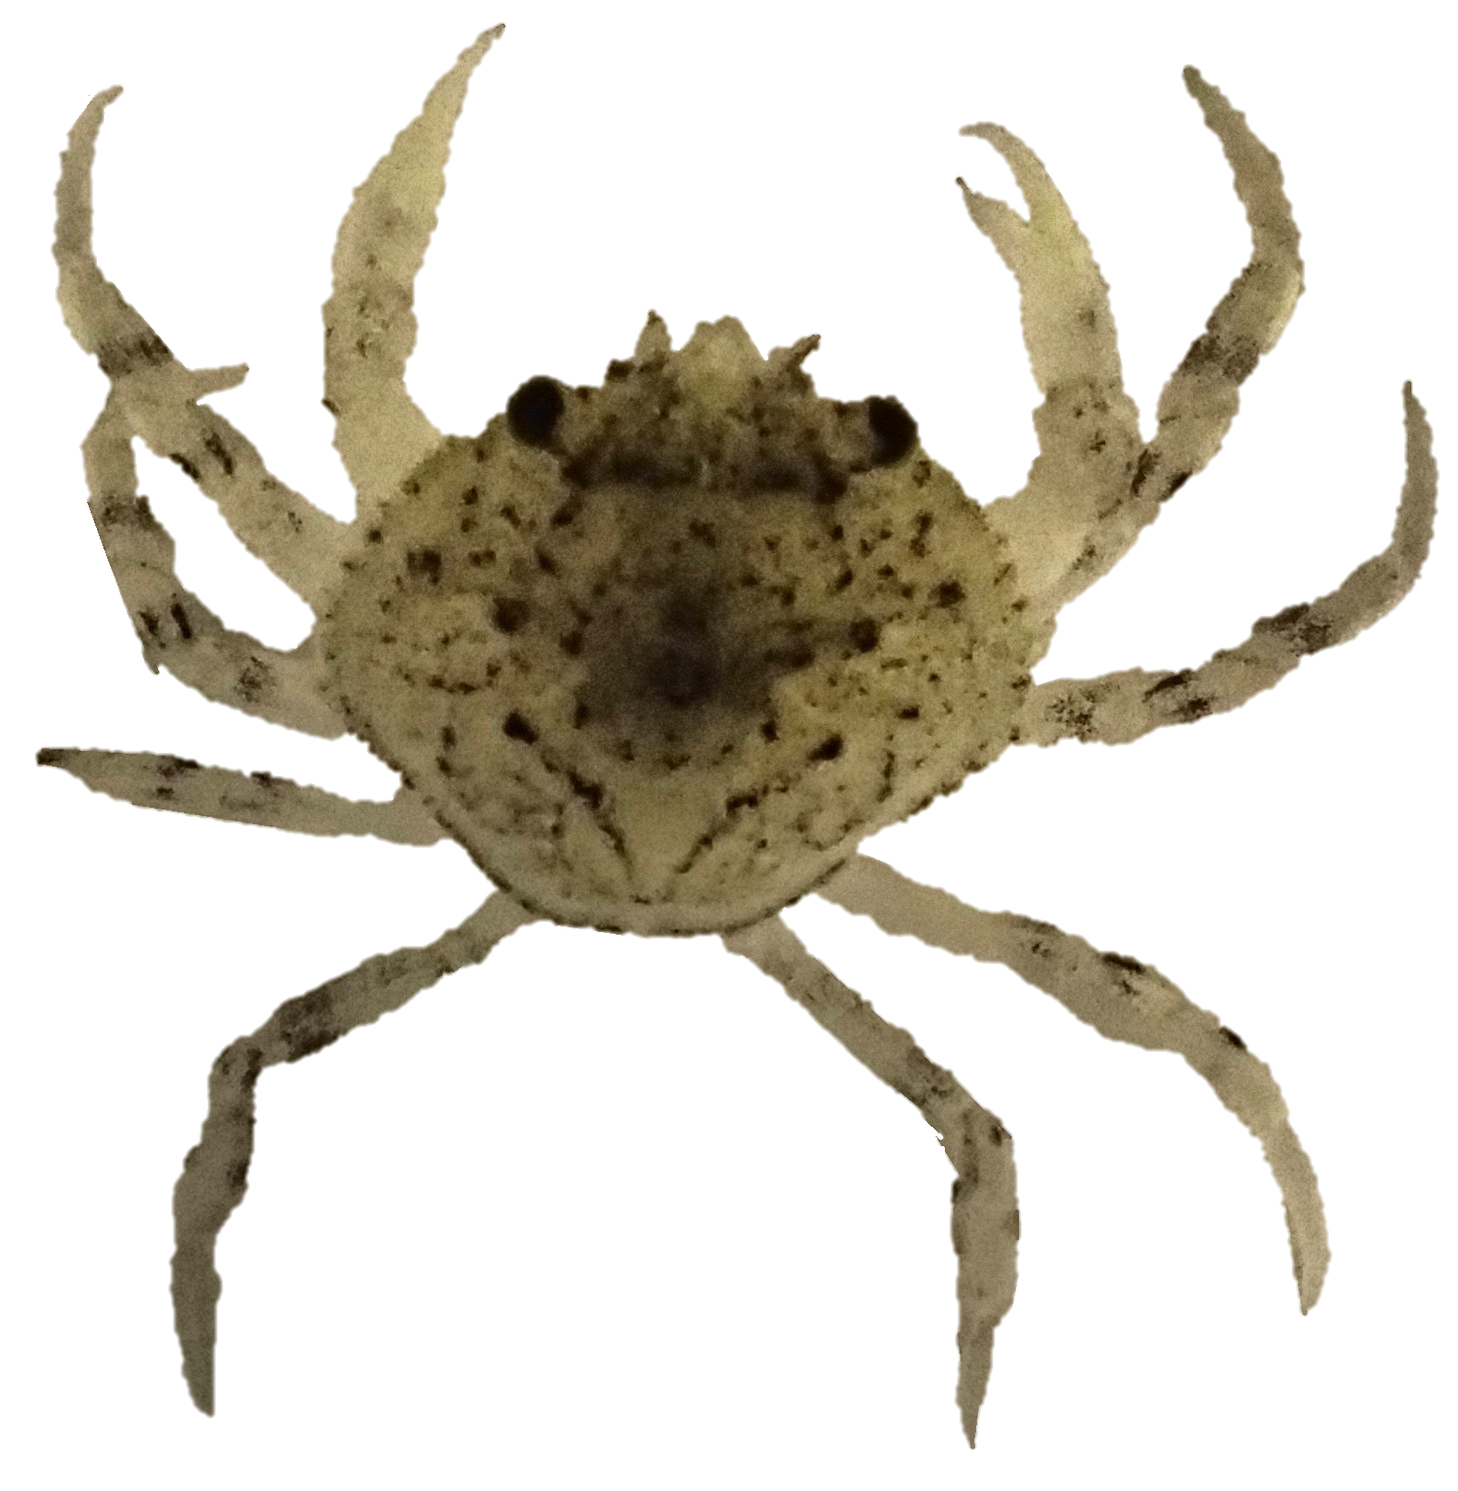
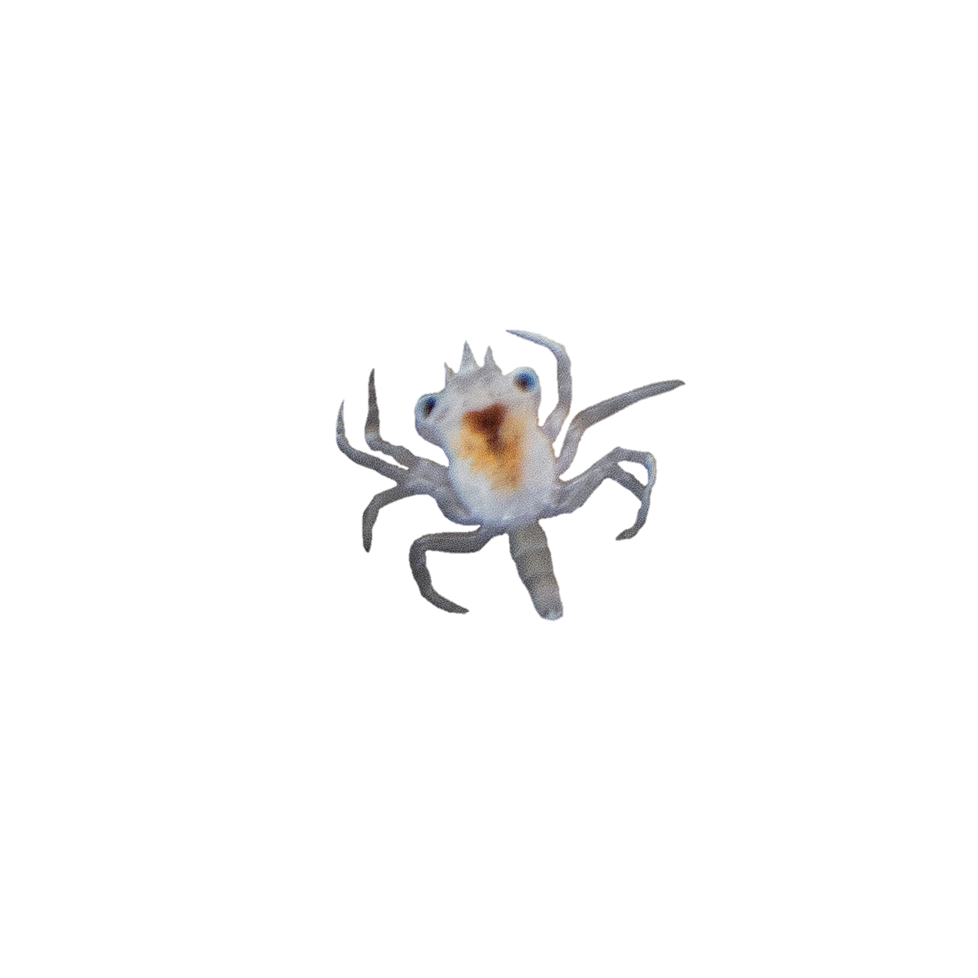
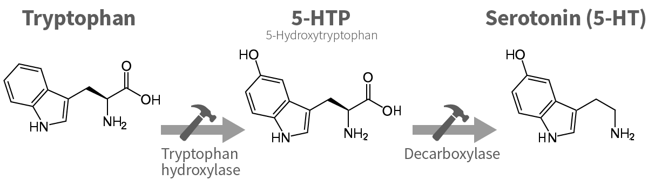
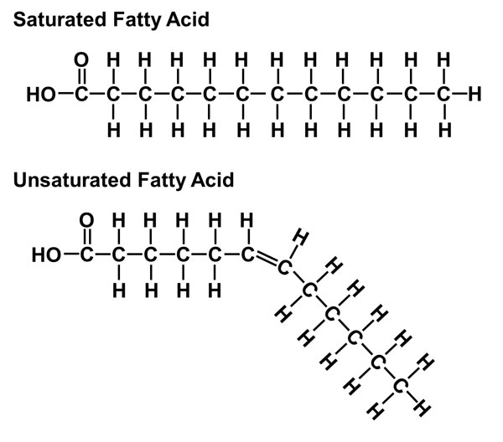
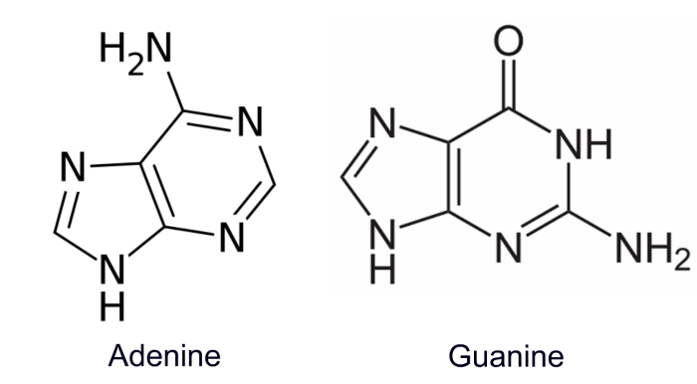
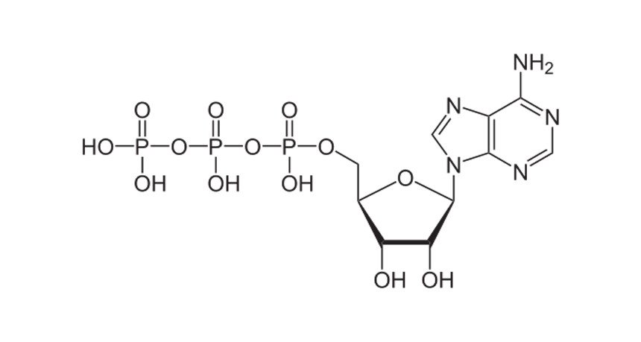
How do young crabs tolerate ocean acidification conditions?
catching larvae in Puget Sound
transferring larvae to individual aquaria
Ocean Acidification Treatment Systems
30-day treatment:
Metabolomics to measure physiology
Norm pH
Norm O₂
Low O₂
Low pH
Low pH
Low O₂
megalopae
1st
Juvenile
Tryptophan
Fatty Acids
Infer activity of pathways
2nd Juvenile
Guanine
LIPID
METABOLISM
Glucose
ATP
No effect on survival
ENERGY
METABOLISM
NUCLEIC ACID METABOLISM
Notes:
The next question the OA lab wanted investigate was how does low pH and low oxygen affect later larval stage development?
To address this, they collected wild-caught late larval stage crabs, transferred each into their own personal aquaria jar, and reared them on these mobile ocean acidification treatment systems. Each system flows filtered seawater and finely controls the amount of CO2 and O2 in the water. There are multiple systems so that different conditions and replicates can be set up. They selected 4 treatment groups to allow effects from each stress to be parsed out. Crabs were reared through the second juvenile stage which on average took 30 days and there were no survival or obvious developmental effects from the treatments. So how are they coping physiologically?

Slide 10
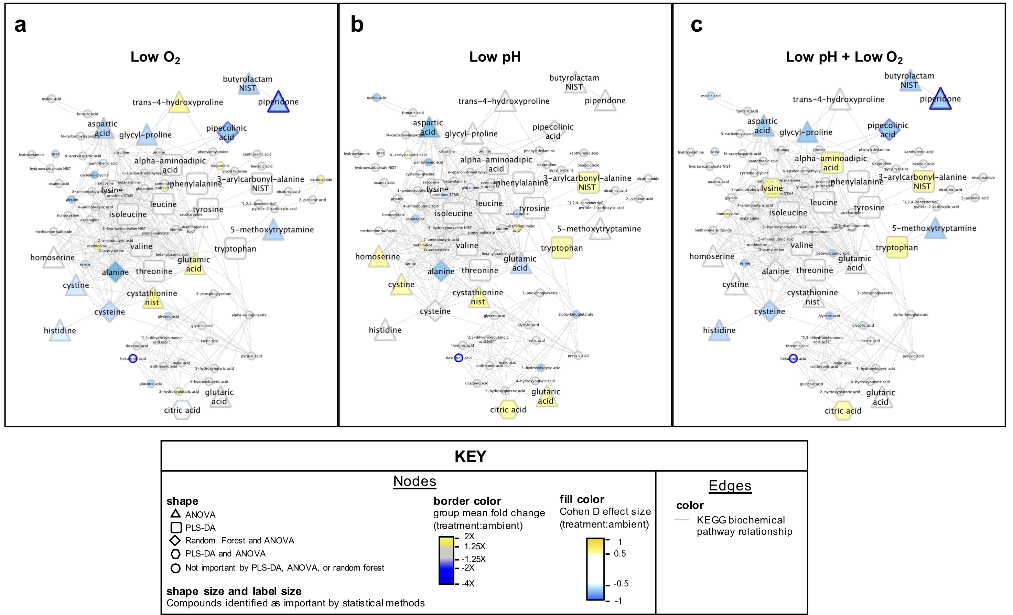
Multi-statistical approach reveals molecular tolerance markers
Abundance relative to ambient
decreased increased no change
Large shapes = significantly affected
Low O₂
Low pH
Low pH + Low O₂
SA Trigg et al. (2019) Scientific Reports
Notes:
This is a complex slide so I’m going to walk you through it
Yellow = increased, blue = decreased
These are amino acids
Different shapes = different stat method, diamond = 2 methods, hex = 3 methods
You can see O2 affects more metabolites than pH

Slide 11
Multi-statistical approach reveals molecular tolerance markers
ENERGY CONSERVATION
Conserved hypoxia responses
(e.g. cysteine degradation up, glutathione synthesis down, lysine degradation down)
ENERGY GENERATION
(e.g. aspartic and maleic acid down citric acid cycle up)
ENERGY CONSERVATION
Conserved hypoxia responses
(e.g. synergistic effects on lysine degradation, synergistic effects on aromatic amino acid metabolism)
Low O₂
Low pH
Low pH + Low O₂
SA Trigg et al. (2019) Scientific Reports
Notes:
This is a complex slide so I’m going to walk you through it
Yellow = increased, blue = decreased
These are amino acids
Different shapes = different stat method, diamond = 2 methods, hex = 3 methods
You can see O2 affects more metabolites than pH

Slide 12
Pteropod metabolomic response to ocean acidification conditions
9-day treatment:
Norm pH
Norm O₂
Low O₂
Low pH
Low pH
Low O₂
No effect on survival
Notes:
Pteropods are important:
Food source for many fish
Grazers of phytoplankton
Shells and detritus stores carbon

Slide 13
Multi-statistical approach reveals molecular tolerance markers
Lipid metabolism broadly altered by low O₂
Sugar metabolism affected by low pH
Low O₂ induces stronger metabolome changes than low pH
Lipids
Sugars
SA Trigg and DS Busch et al. (2021) In prep.
Notes:
Low O2 => adjust lipid metabolism to make membranes more permeable to O2
Low pH => increase sugar metabolism to fuel proton pumps for acid/base regulation

Slide 14
Proteome response to warming
DNA
RNA
DNA
RNA
DNA
RNA
DNA
RNA
DNA
RNA
Genome
all genes or genetic material
Transcriptome
all RNA strands transcribed from DNA
Proteome
all proteins
Interactome
all interactions between proteins
Metabolome
all small molecule byproducts of biochemical reactions (metabolites)
Meal prep analogy
Recipe
1.
2.
3.
4.

Slide 15

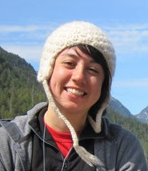

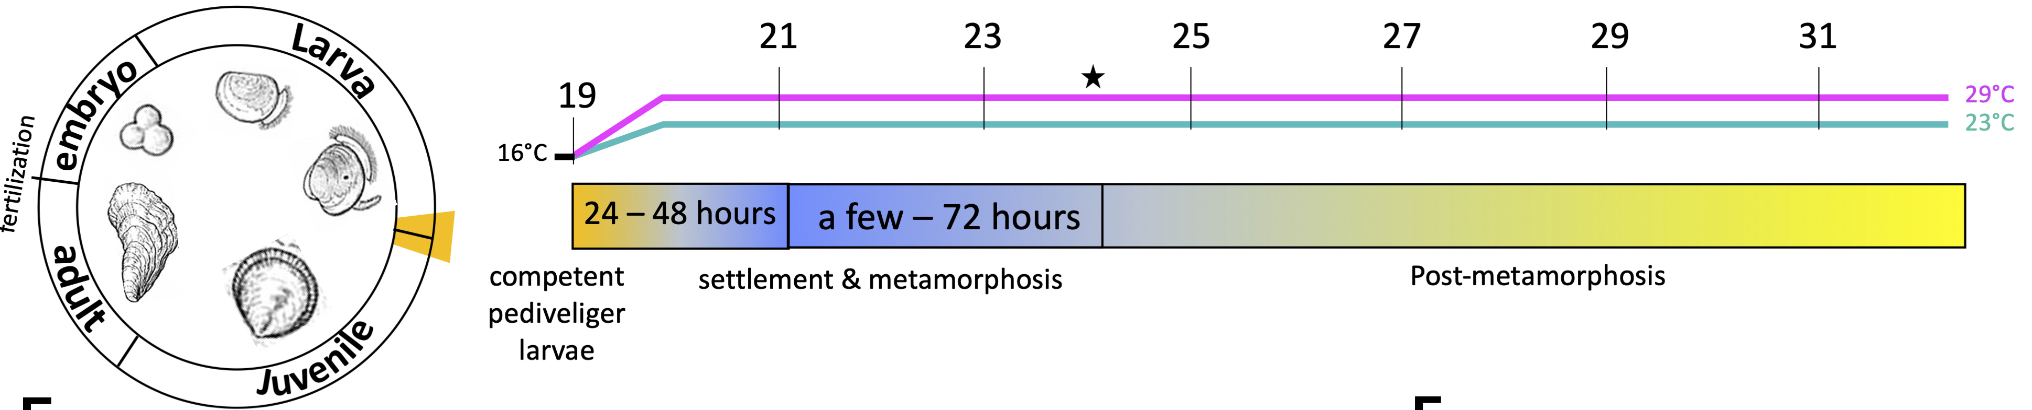
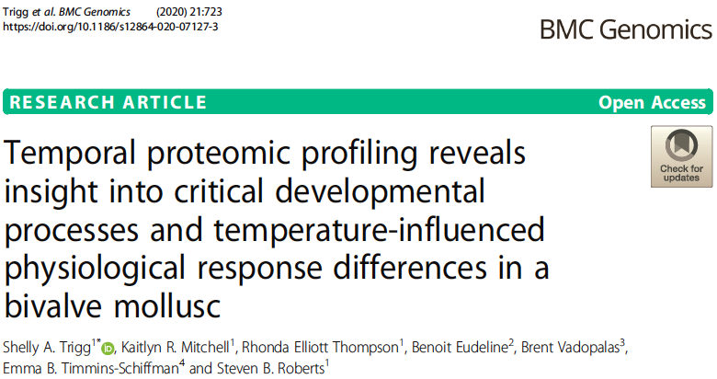
Oyster response to warm temperature
Rhonda Elliot

Slide 16
Oyster response to warm temperature
No effect on survival
oysters in warmer temperature are larger
Proteomics to measure physiology
SA Trigg et al. (2020) BMC Genomics. https://doi.org/10.1186/s12864-020-07127-3

Slide 17
Multivariate statistical analyses reveal protein markers of improved performance
ANOVA-Simultaneous component analysis to tease apart effects from time and temperature
Temperature effect
SA Trigg et al. (2020) BMC Genomics. https://doi.org/10.1186/s12864-020-07127-3

Slide 18
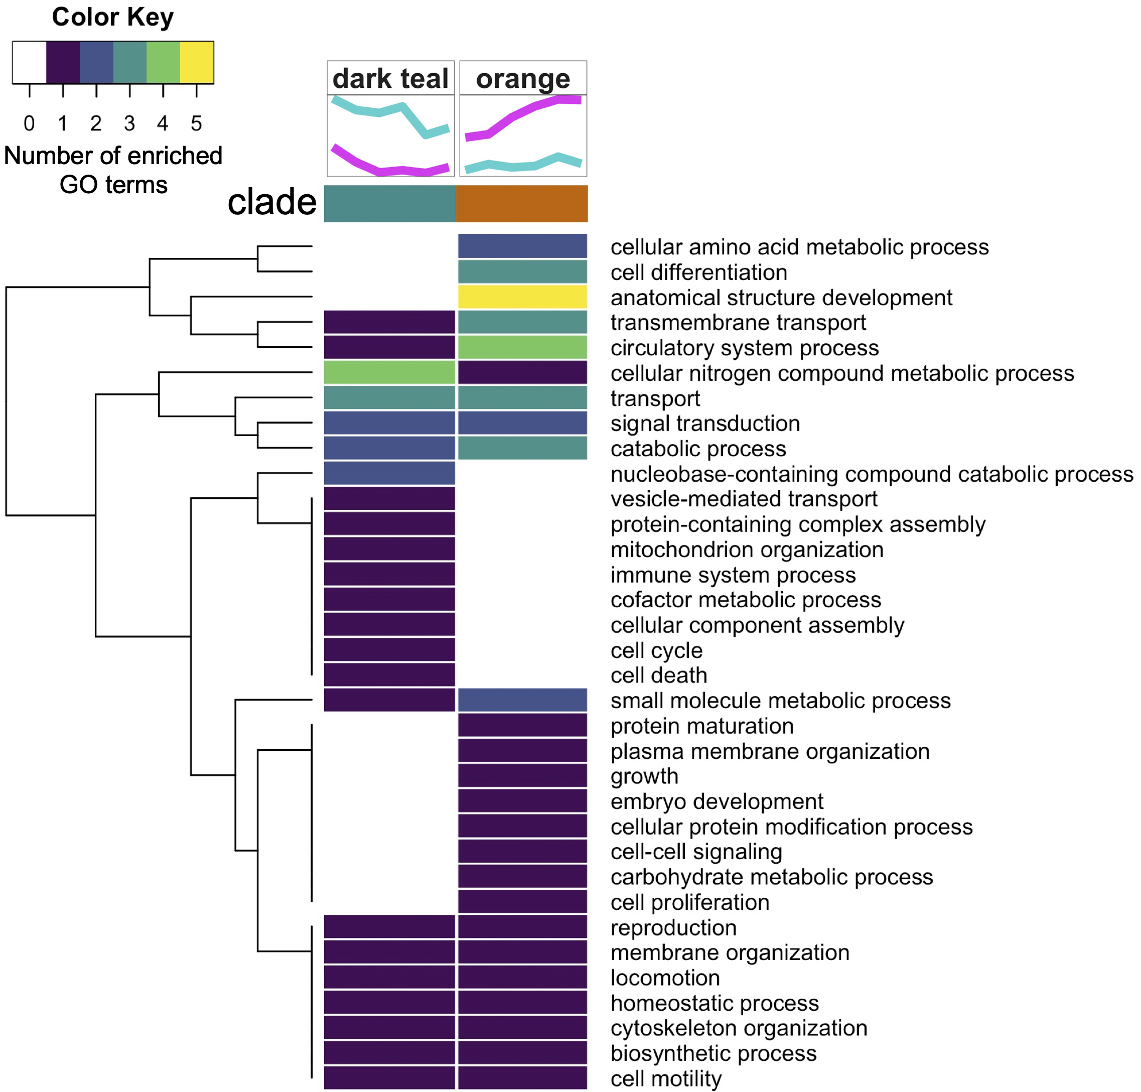
Protein markers of improved performance
In metamorphosing oysters, warmer temperature led to:
larger size
increased growth pathways
decreased immune response pathways
SA Trigg et al. (2020) BMC Genomics. https://doi.org/10.1186/s12864-020-07127-3

Slide 19
Methylome response to environmental change
DNA
RNA
DNA
RNA
DNA
RNA
DNA
RNA
DNA
RNA
Genome
all genes or genetic material
Transcriptome
all RNA strands transcribed from DNA
Proteome
all proteins
Interactome
all interactions between proteins
Metabolome
all small molecule byproducts of biochemical reactions (metabolites)
Meal prep analogy
Recipe
1.
2.
3.
4.

Slide 20
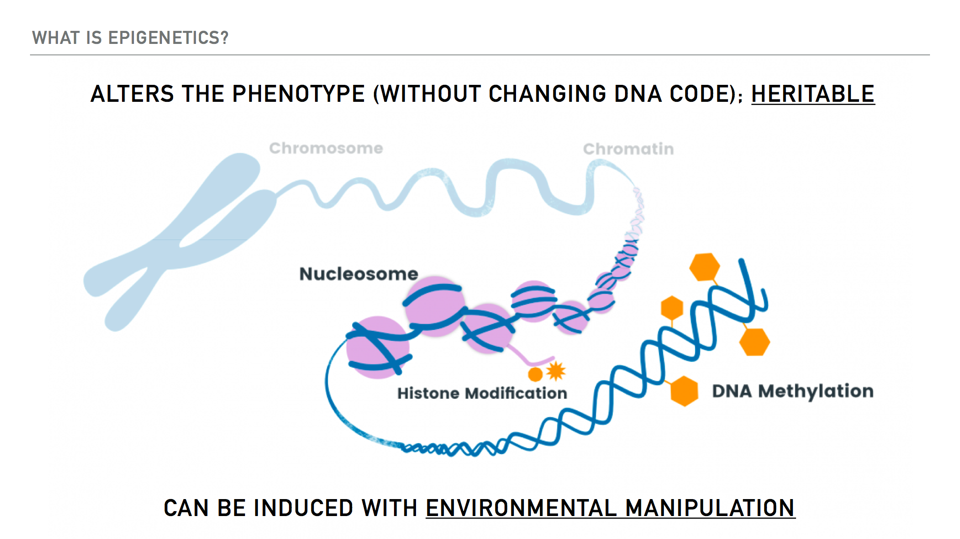
Recipe
1.
2.
3.
4.
Notes:
So these are chemical marks for instance on the DNA that can alter phenotype without changing the DNA code itself. And these marks can be passed on to offspring. These marks can also be induced by environmental manipulation

Slide 21
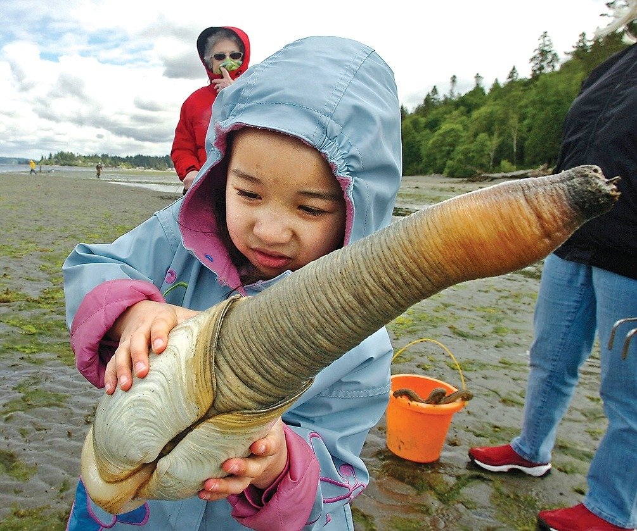
Pacific geoduck response to pH
Geoduck are important:
One of the most valuable farmed shellfish (>$20 M/year in WA)
Biofilter and prey source
Tribal sustenance
Notes:
If this is your first introduction to Pacific Geoduck, these are large clams tat inhabit the Northeastern Pacific from Alaska down to
Geoduck are important economically being the most valuable farmed shellfish on a per acre basis brining in over 20M in annual sales in WA state alone. They are important ecologically serving as biofilters and as a prey source. And they are important culturally, having sustained tribes by providing a food and revenue source.
The name geoduck = Nisqually for dig deep

Slide 22
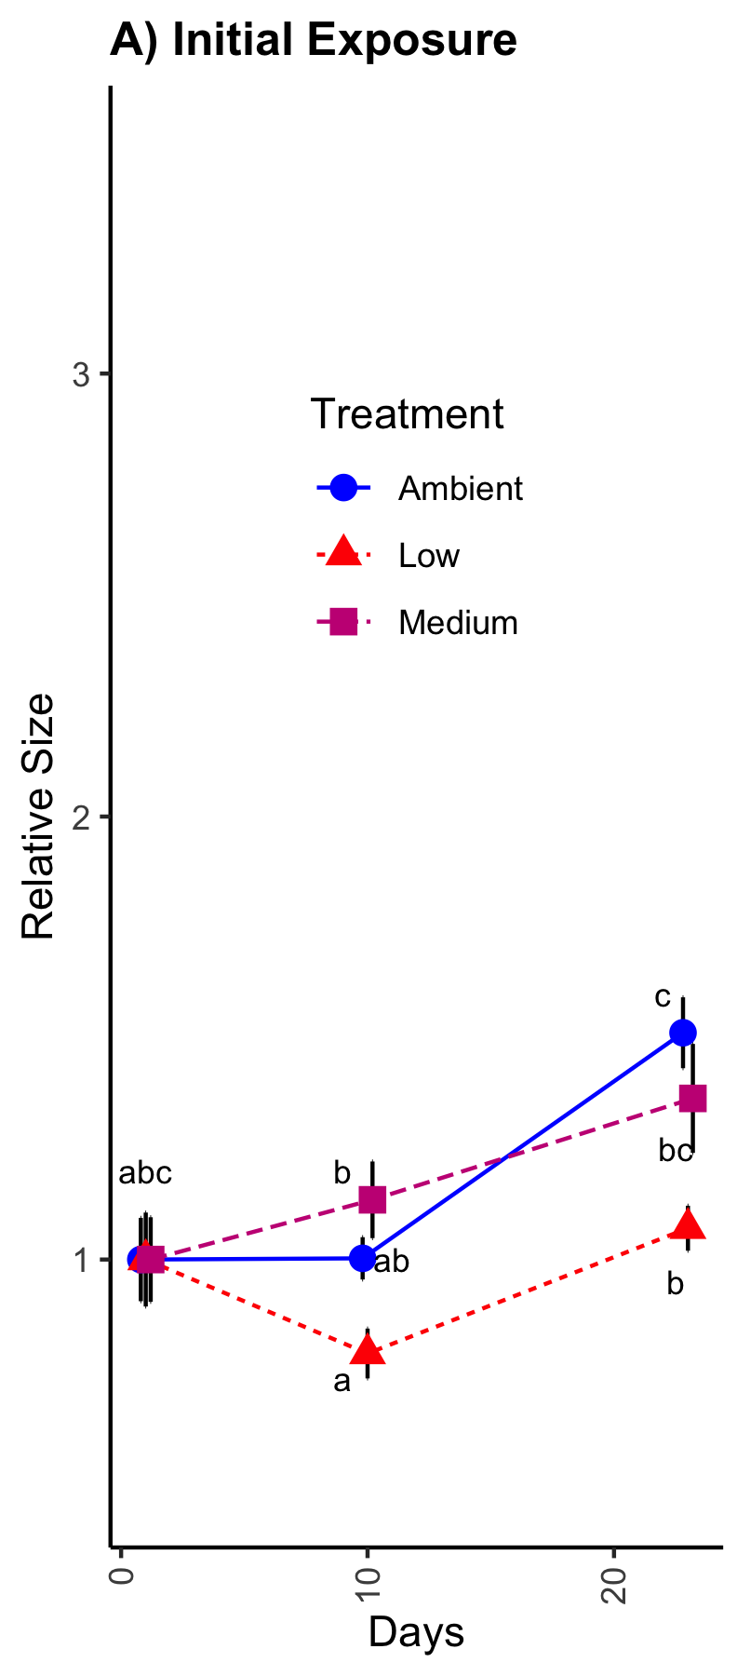

Static low pH initial exposure delays juvenile growth
Dr. Hollie Putnam, URI

Slide 23
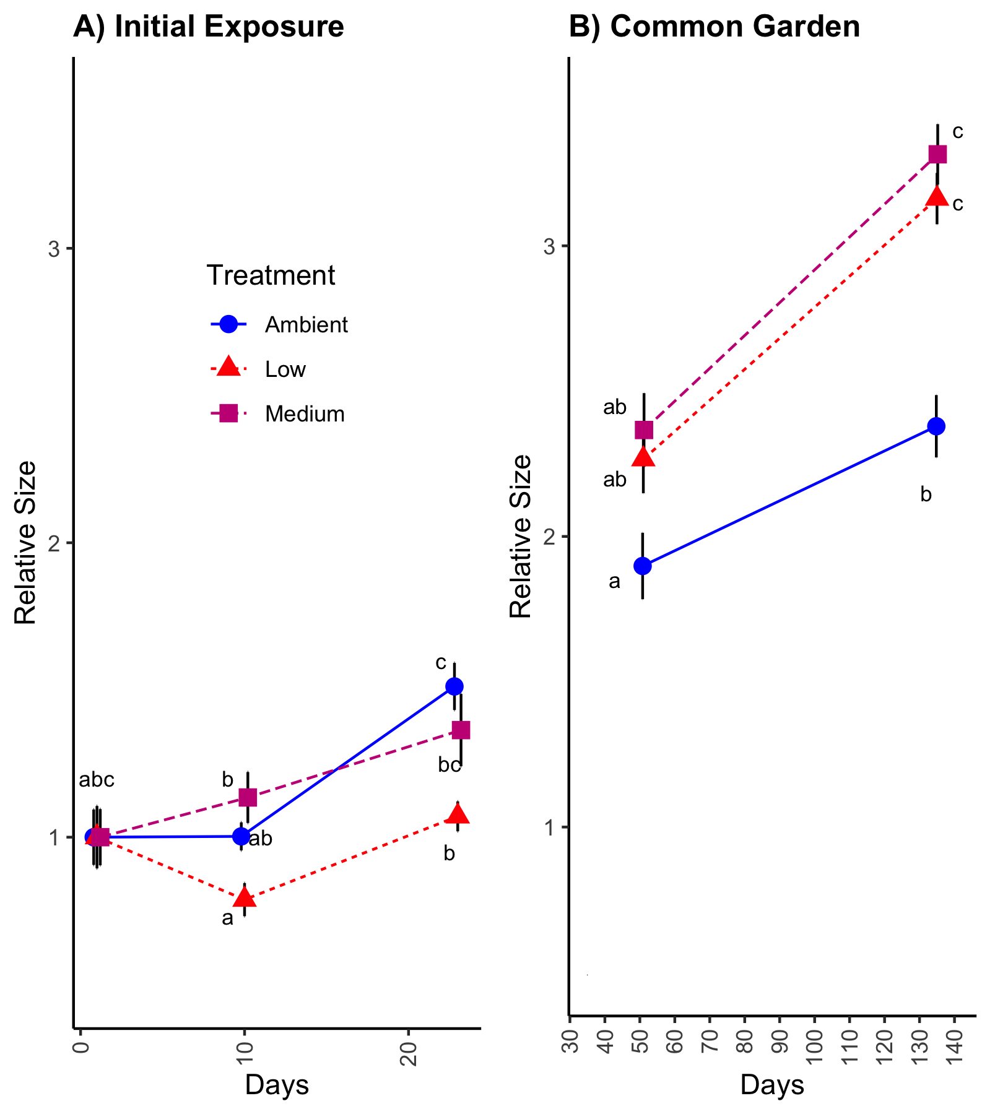
Static moderate and low pH initial exposure leads to accelerated growth after common garden
Dr. Hollie Putnam, URI

Slide 24
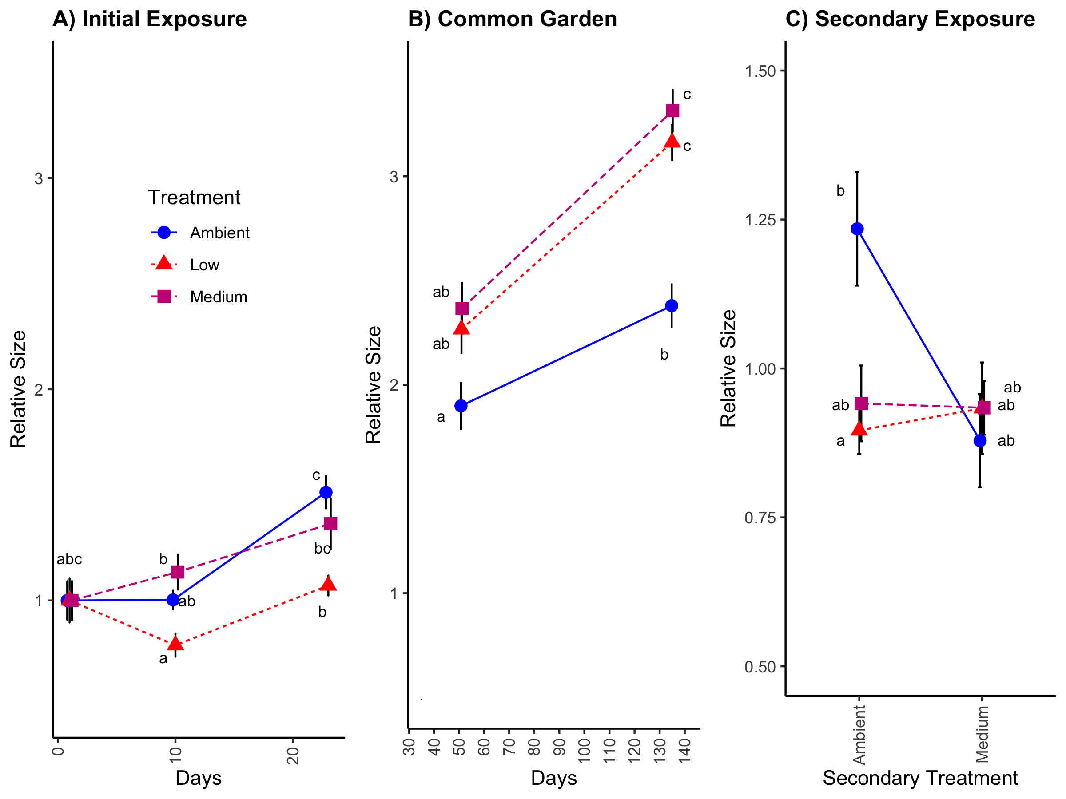
Static moderate and low pH initial exposure protects against growth delay induced by secondary low pH exposure
Dr. Hollie Putnam, URI
Notes:
To investigate possible molecular underpinnings of these growth phenotypes,

Slide 25
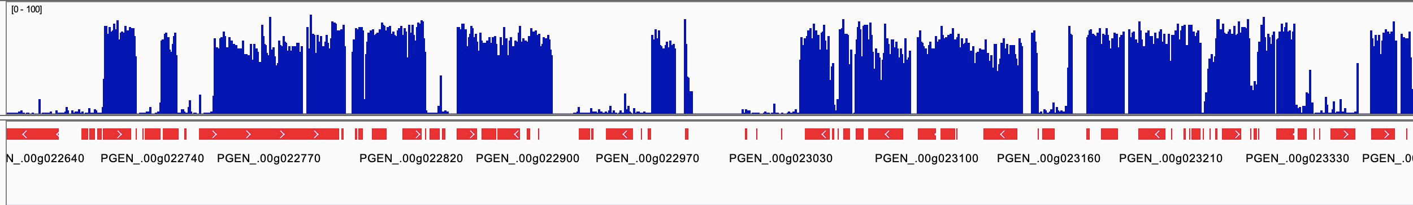
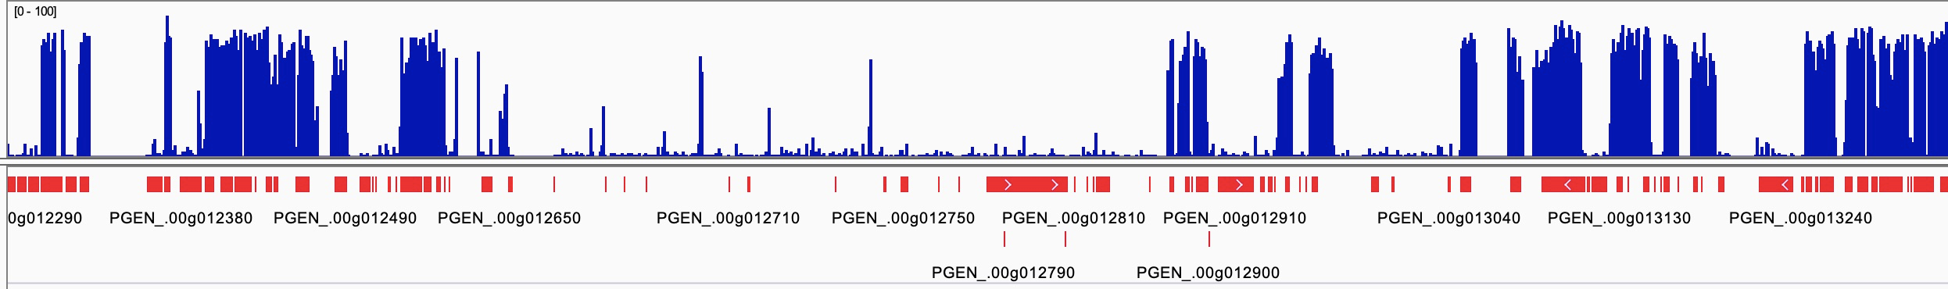
Geoduck genome methylation is primarily in genes
HM Putanm and SA Trigg et al. (2021) In prep.
Notes:
This is a snap shot of the DNA methylation landscape of the genome which generally shows high methylation density within genes.

Slide 26
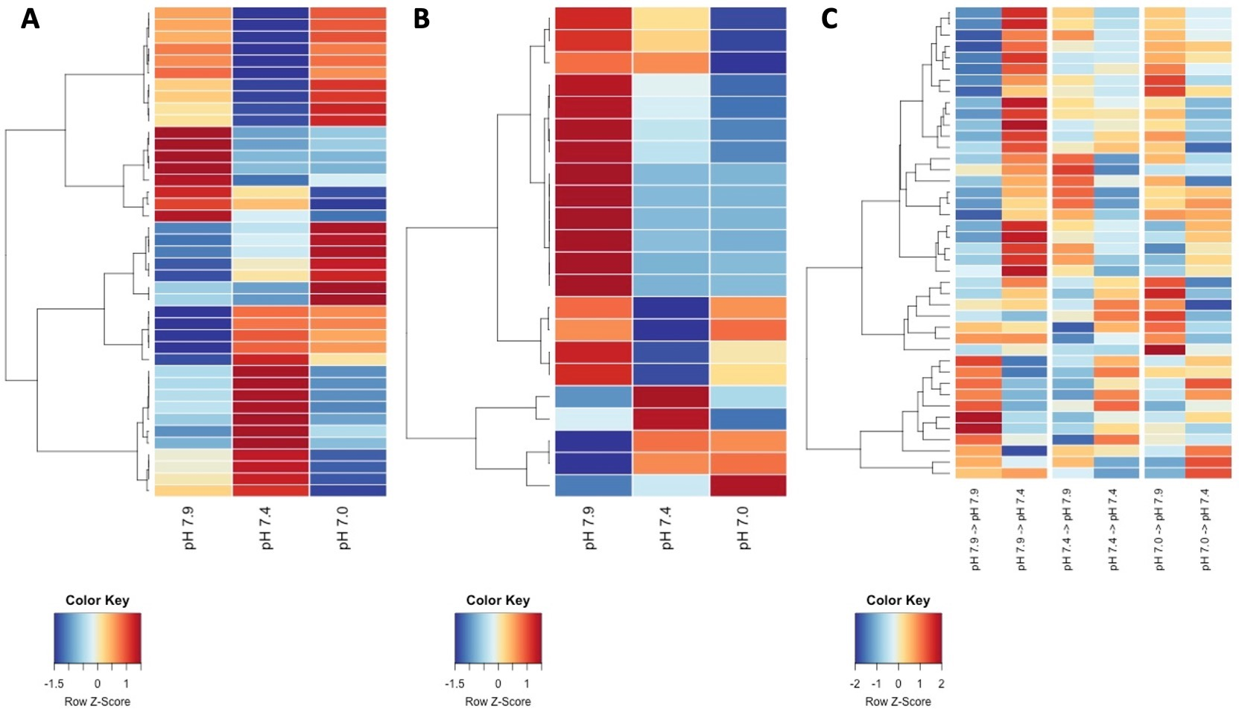
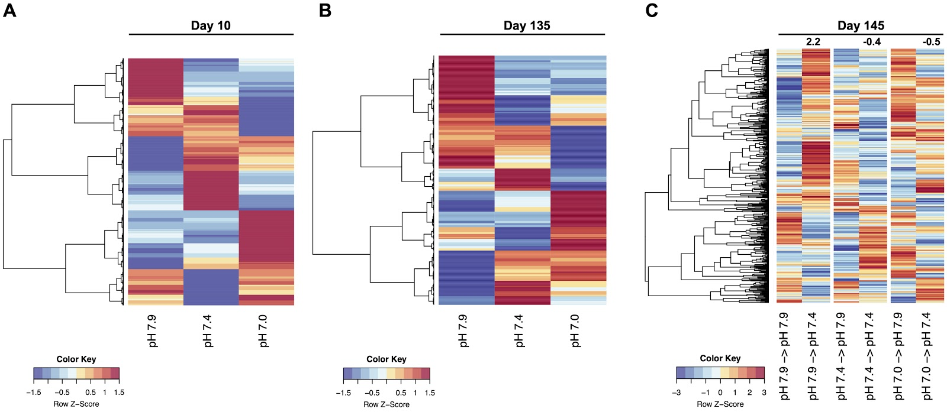
Multistatistical approaches identify differentially methylated regions and genes
Permutation test + root mean square error test + ANOVA to identify regions
Methylpy (M Schultz et al. 2015 Nature; github.com/yupenghe/methylpy)
Binomial GLM to identify genes
YJ Liew et al. 2019 Science Advances; github.com/lyijin
After common garden (112 days post-exposure)
10 days of 2nd exposure
10 days of exposure
HM Putanm and SA Trigg et al. (2021) In prep.
Notes:
Cytoskeleton activity related increased growth after common garden
Nucleic acid binding and mitochondria associated processes related to

Slide 27
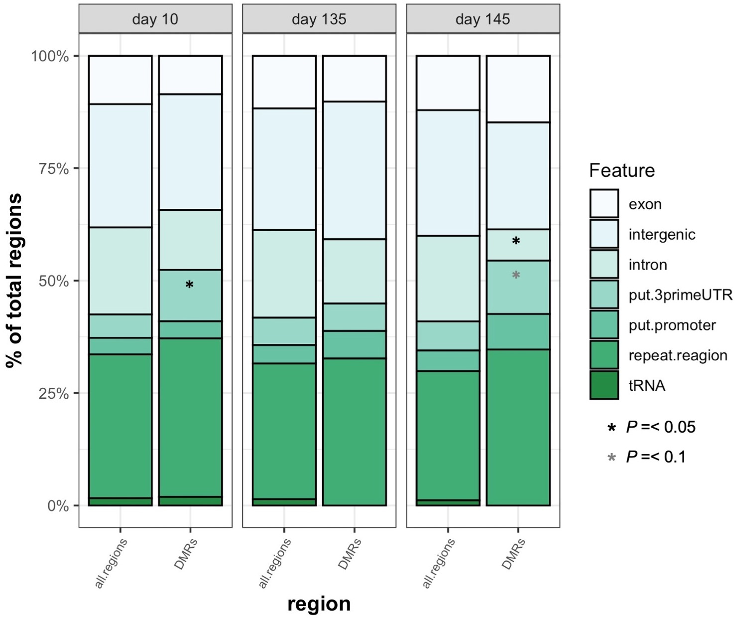
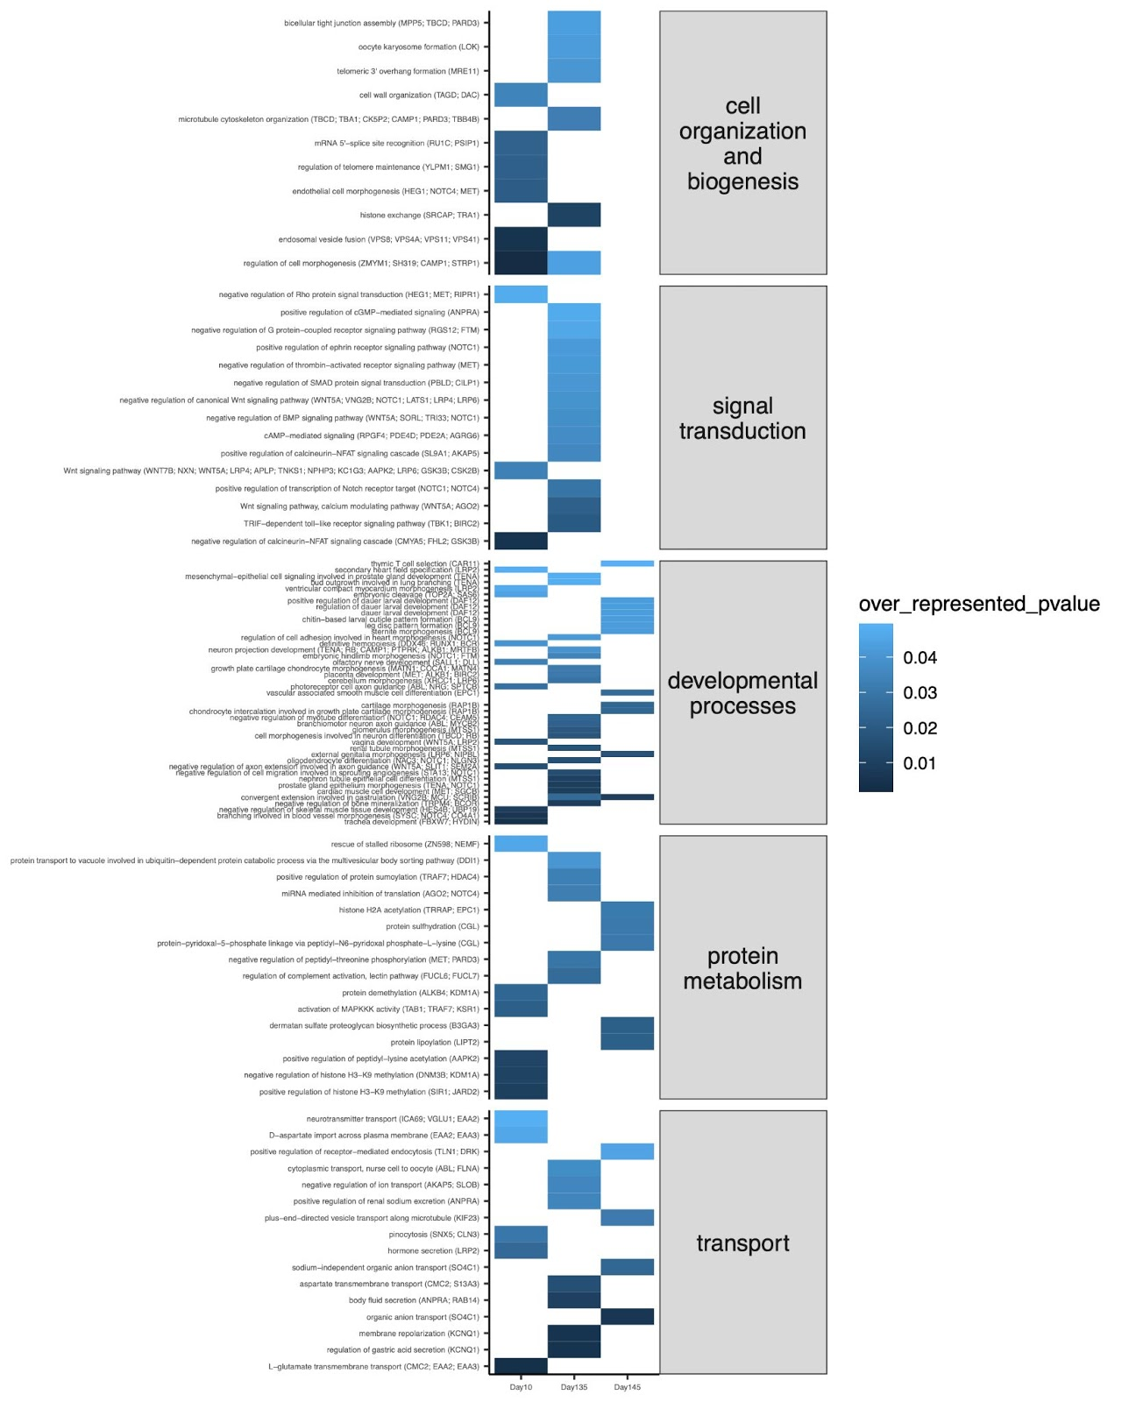
pH resilience and compensatory growth linked to signaling pathways and cytoskeletal processes
Differentially methylated regions are within or adjacent to genes
Differentially methylated genes implicate specific biological processes
Acute effect and longer-term effect on Wnt signaling
Genes involved in cytoskeletal activity
Genes involved in nucleic acid binding and mitochondrial activity
HM Putanm and SA Trigg et al. (2021) In prep.
Notes:
Differences in methylation alter expression patterns.
Achieve pH resilience and growth performance through altering methylation of genes involved in wnt signaling and related growth pathways

Slide 28
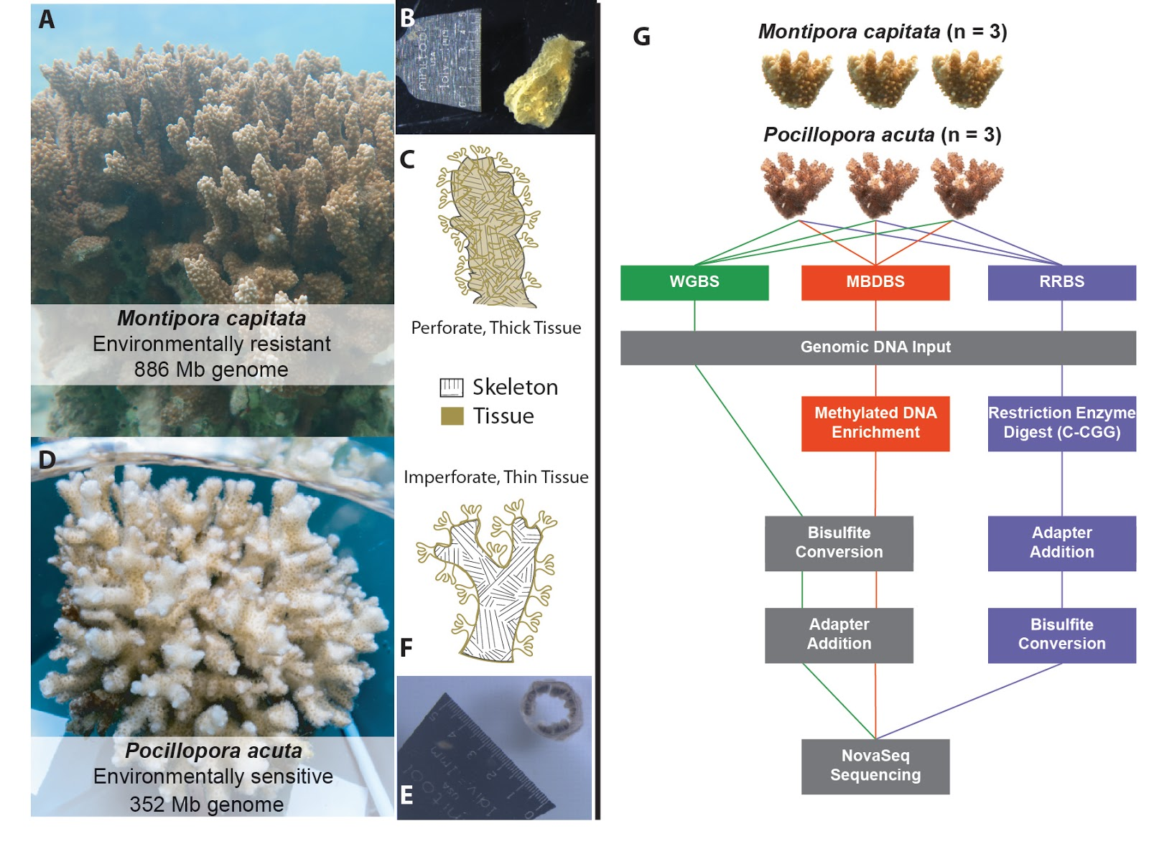
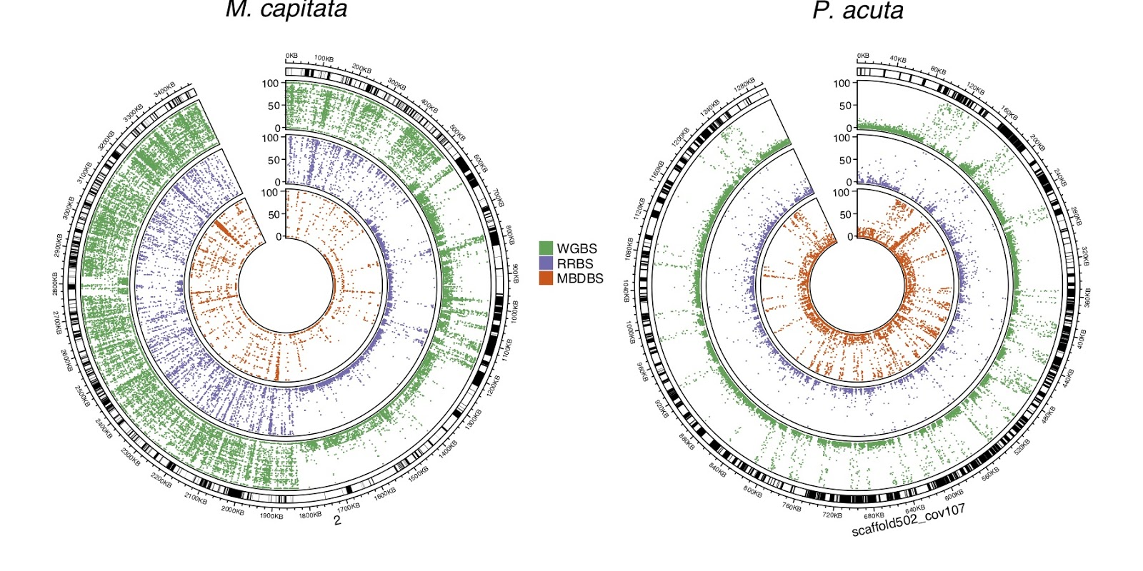

DNA methylation underlies environmental tolerance in corals
SA Trigg and YR Venkataraman et al. 2021. Invertebrate methylomes provide insight into mechanisms of environmental tolerance and reveal methodological biases. Molecular Ecology Resources. Submitted. bioRxiv https://doi.org/10.1101/2021.03.29.437539

Slide 29
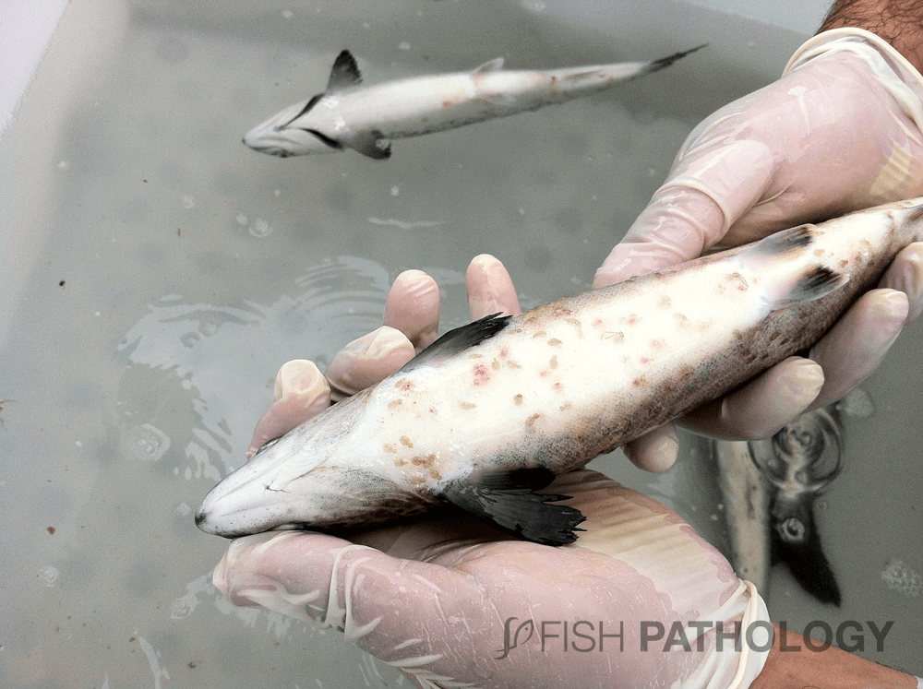
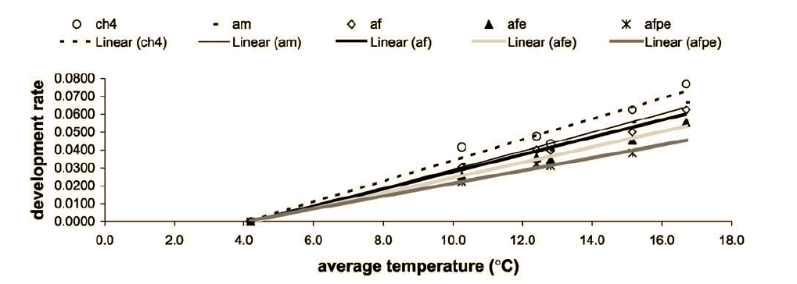
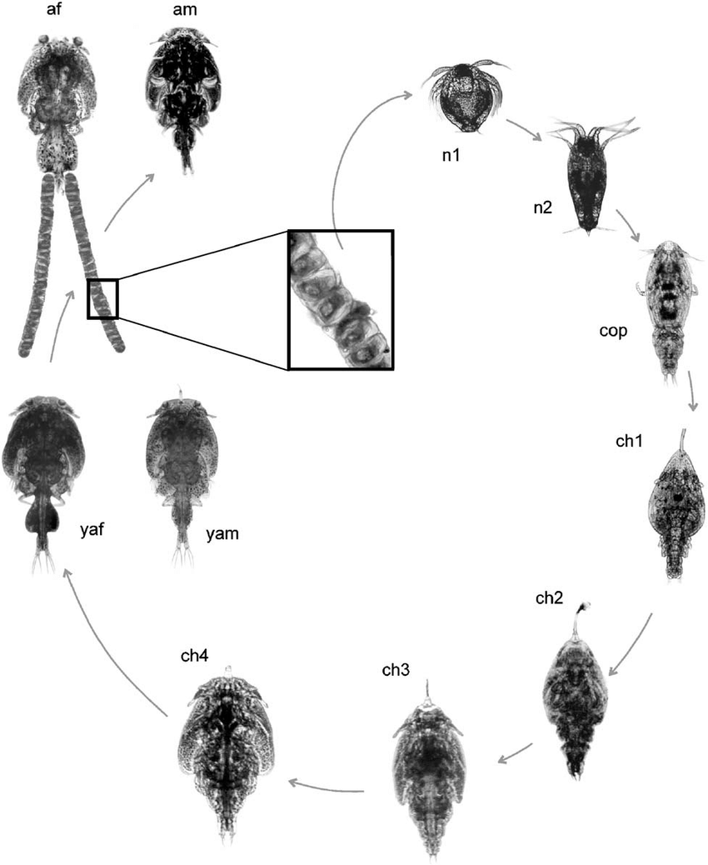
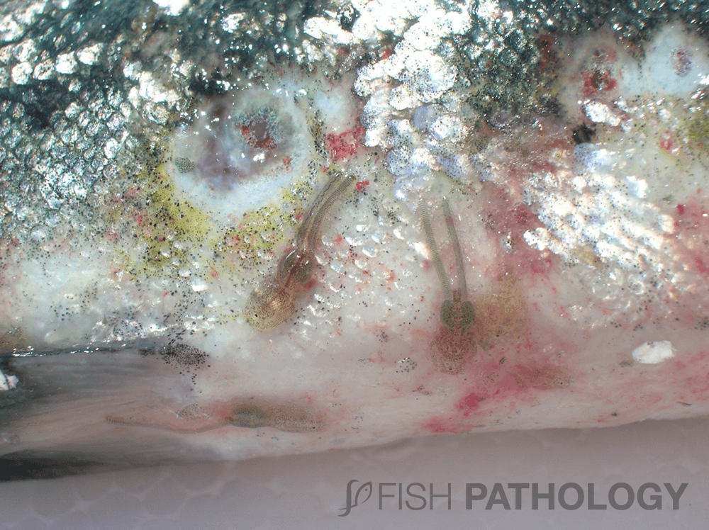
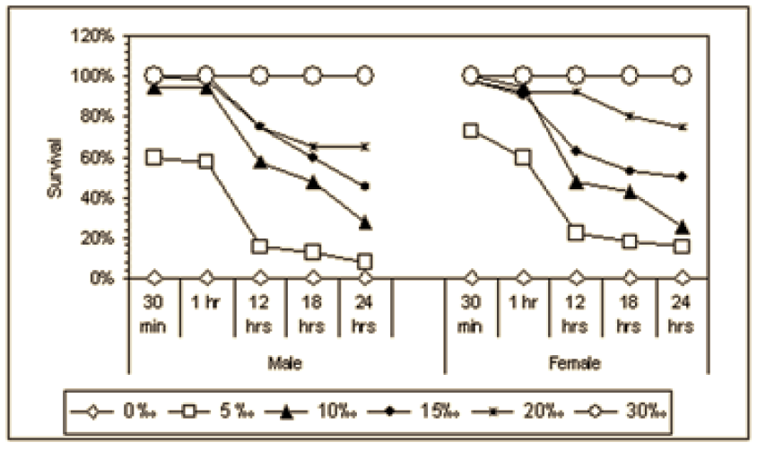
Temperature and salinity effect on salmon infested with sea lice
Warmer temperature increases sea lice development rate
Lower salinity reduces sea lice survival
Bravo et al (2008) Bulletin of the European Association of Fish Pathologists

Slide 30





DNA methylation varies with conditions
SA Trigg et al. 2021. Environmental influence on Atlantic salmon epigenome during sea lice infestation. In prep

Slide 31
Outline
Background on environmental change and omics
Exposure experiments and omics analyses in different marine animals
Summary of the diversity in animal responses
Future directions

Slide 32
Diversity in animal response to environmental change
Animal | Condition | Duration | Life stage | Performance phenotype | Omics data | Molecular phenotype
Dungeness crab | Low pH x Low O2 | 31 days | larvae -> juvenile | No survival difference | metabolomics | pH increases energy generation pathways Low O2 increases energy conservation pathways Low O2 response is dominant
Pteropods | Low pH x Low O2 | 7 days |  | No survival difference | metabolomics | Low O2 increases phosphatidylcholine metabolism Low pH increases large sugar acids
Pacific oyster | Warming (23C vs 29C) | 13 days | larvae -> juvenile | No survival difference Larger size | proteomics | Increased growth pathways Decreased immune response pathways
Pacific geoduck | Low pH reciprocal exposure | 20 days then 10 days | juvenile | No survival difference Larger size and resilience to growth delay | DNA methylation | Wnt signaling
Montipora capitata vs. Pocillopora acuta | Ambient | n/a | mature | Environmental change resilience | DNA methylation | Dense gene body methylation
Atlantic salmon + sea lice | Warming and reduced salinity | 30 days | juvenile | No survival difference | DNA methylation and transcriptomics | Putative promoter methylation is enriched Reduced salinity increases methylation
Notes:
Animals show diverse molecular responses. But are there common molecular patterns that might indicate how an animal might perform in the future?

Slide 33
Outline
Background on environmental change and omics
Exposure experiments and omics analyses in different marine animals
Summary of the diversity in animal responses
Future directions

Slide 34
Leveraging genomics datasets to predict animal response
Growing genomics resources and tools in marine species
Many species, many phenotypes, lots of omics data
Biomarker discovery for biomonitoring (e.g. early detection of disease or pollution) and predicting species response to environmental change (e.g. migration patterns)
Comparative species genomics analysis to identify markers associated with environmental variation and performance phenotypes
Notes:
Biomarkers could be individual molecules or they could be pathways

Slide 35
Stratifying data to predict how animals will fare in the future
Outcomes
Biomarker database
detect early signs of poor performance
Energy efficient vs. not
Notes:
If a group of animals

Slide 36
Marine omics for future biomonitoring
Promises
CHALLENGES
Many factors to consider
Species
Life stage
Environmental parameters
Experiment duration
Performance phenotype
Sequencing technology variation
Potentially could be normalized with commonly measured molecules
Data quality
Thresholds could be set based on internal standards
Data storage/management and computing power needs
Storage is becoming cheaper
Integration across different fields/disciplines
Ripe for collaborations!
Quicker, cheaper, more efficient data collection
A lot more data than traditional methods
High resolution answers to research questions
May lead to more sensitive and accurate biomonitoring

Slide 37
Acknowledgements
Roberts Lab, UW
Steven Roberts
Yaamini Venkataraman
Laura Spencer
Grace Crandall
Sam White
Kaitlyn Mitchell
Rhonda Elliot
Brent Vadopalas
Putnam Lab, URI
Hollie Putnam
Sam Gurr
Genome Sciences, UW
Emma Timmins-Schiffman
NOAA NWFSC
Krista Nichols
Shallin Busch
Paul McElhany
Mackenzie Gavery
Michael Maher
Danielle Perez
Caitlin O’Brien
Questions?
Email me at shelly.trigg@gmgi.org

